Slide 1



All About Sexual Harassment
A presentation for K-5 students
Office of Safety and Youth Development
School year 2023-2024
Notes:
In this Powerpoint, students in grades K-5 will learn about student-to-student sexual harassment. The Powerpoint is divided into topics including consent, body boundaries, word boundaries, and telling adults. Feel free to add case scenarios or role plays to supplement throughout. This Powerpoint can be facilitated by the Sexual Harassment Prevention liaison, or by the principal/designee or health educator with the SHP liaison’s support.
Note: The presenter should tailor their delivery of the slide content as age (i.e., grade level) and developmentally appropriate for the student audience.
Time: 30 minutes
Note: This Powerpoint can be used to kick off a conversation about sexual harassment, but should not be the only discussion of sexual harassment throughout the school year. Lessons in health education, advisory groups, and other classes should go over sexual harassment throughout the year with your school’s Sexual Harassment Prevention liaison present. Learn more about health education requirements, supports, curriculum, and standards by clicking here: https://infohub.nyced.org/nyc-doe-topics/teaching-learning/health-education
Objectives:
1.Students will be able to identify sexual harassment and avoid using sexually harassing behaviors.
2.Students will be able to identify consent and non-consent, and respect the choices of others.
3.Students will learn how to make a report of student-to-student sexual harassment.
Setting:
This presentation is best done in a classroom or advisory setting. Please avoid large-audience presentations, as these make it hard to fully engage with the audience, and don’t allow for much age-specific discussion. Lastly, these presentations are best when all audience members are in the same grade.
Materials:
For this presentation, you will need to project this Powerpoint in a space that has audio and visual capability. You will also need to provide every student with a copy of Chancellor’s Regulation A-831 and the Sexual Harassment Brochure.
Preparation:
To prepare for this presentation, ensure that your Sexual Harassment Prevention liaison has attended the Student-to-Student Sexual Harassment Designated Staff training, and go over this presentation with them to ensure that you are prepared to handle any questions or situations that might arise. You should also have discussed student-to-student sexual harassment with staff already, so that staff are able to support the activities and learning throughout the presentation.
Also, there is a role play activity on Slide 5 that you should review first, and ask a staff member to participate in. Lastly, there is a slide on page 13 where you should fill in the name of the Sexual Harassment Prevention liaison.
What to expect:
During or after this presentation, students might disclose incidents of sexual harassment, or talk or joke with each other about what they learned. Connect with your Sexual Harassment Prevention liaison and health educator to develop a unified strategy on how to respond to such discussions.

Slide 2









What will we talk about?
Consent
Body Boundaries
Word Boundaries
Reporting
Notes:
Say, “We are here today to learn more about ways that we can feel safe and comfortable at school. Today we’re going to learn some new words to keep us safe. The first word is ‘consent.’ It just means telling someone that it is okay to do something, or giving permission. The next word is ‘boundaries.’ Those are the imaginary lines we can’t cross. We’ll talk about body boundaries and word boundaries. This is all part of talking about ‘sexual harassment,’ which is when someone crosses someone else’s boundaries without consent, or uses hurtful words in a certain way. Last, we’ll talk about how to tell adults if something is wrong.”

Slide 3






Agreements
One mic | Respect each other | Ask for help
Right to pass |  | Avoid sharing personal stories
Notes:
Say, “First, let's go over some rules that we will all agree on to make sure that everyone feels safe, supported, and heard in this space. What does ‘one mic’ mean?”
Take some responses, and thank responders for their answers.
Say, “One mic means that only one person should be talking at a time. The next rule is that we should respect each other. That means we should respect what each other says or does during this presentation, and be kind to each other. Some people might not know some of the words that we’ll use, and that’s okay! We’re all different, and have different ideas and understanding.
Also, if you have a question or have something to say, or if there is anything that we talk about here today that makes you upset or uncomfortable and you'd like to step out, please make sure to raise your hand and ask for help.
That doesn’t mean you have to say anything though. You are allowed to ‘pass’ on any question or discussion if you want to.
Lastly, during this presentation, please don’t share personal stories, or stories about others. If you want to report something that happened to you, you can talk to a staff member after the presentation, or ask to speak to someone privately.”

Slide 4


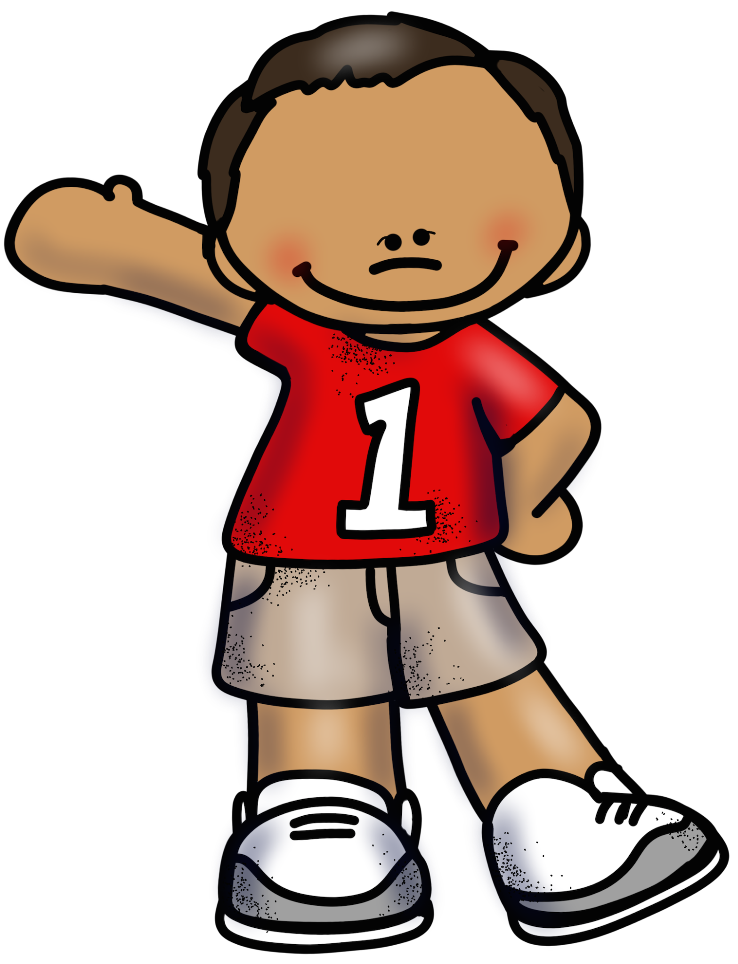
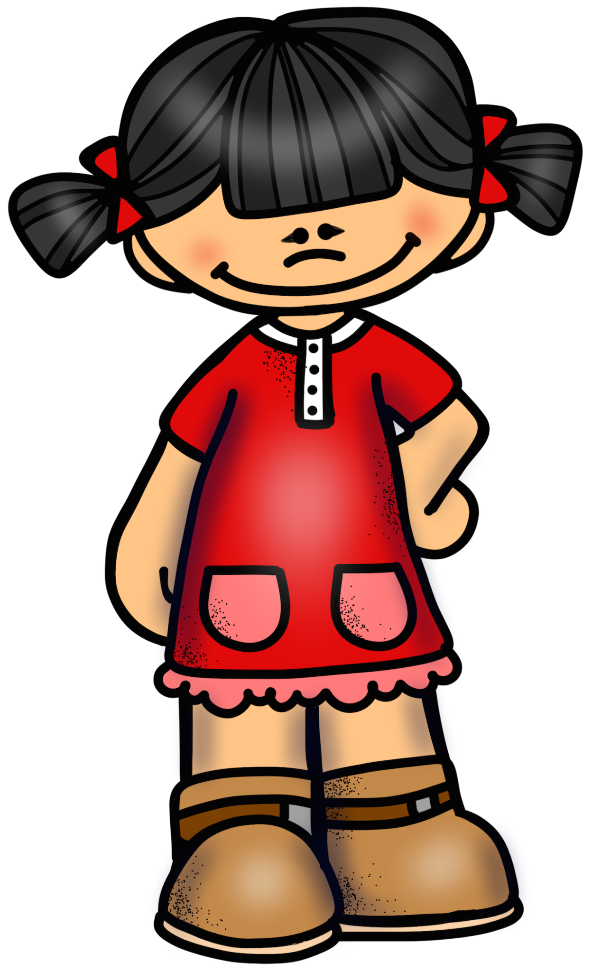
Consent
Notes:
Say, “Has anyone heard of the word ‘consent’? What does it mean?”
Take some responses, and thank responders for their answers.
Say, “Consent just means ‘permission to do something.’ What is permission?”
Take some responses, and thank responders for their answers.
Say, “Permission means that someone tells us it’s okay. What are some things we need to ask permission for?”
Possible answers might include: leaving class to go to the bathroom or restroom, borrowing someone’s pencil, playing a game together, etc.
Say, “Great job! Those are some examples of things we need consent or permission for. What are some words that we might use to ask someone for consent or permission?”
Take some responses, and thank responders for their answers. Move to the next slide.

Slide 5
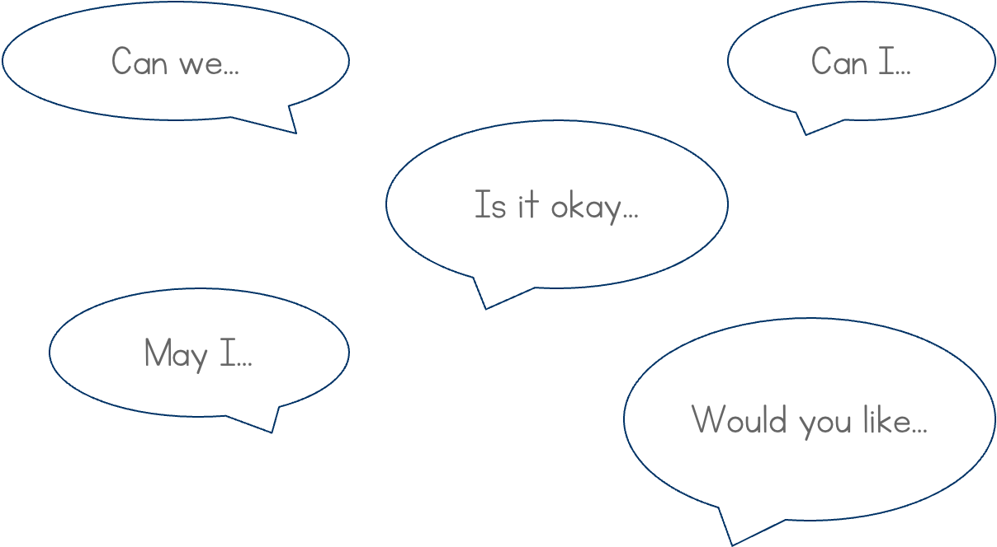
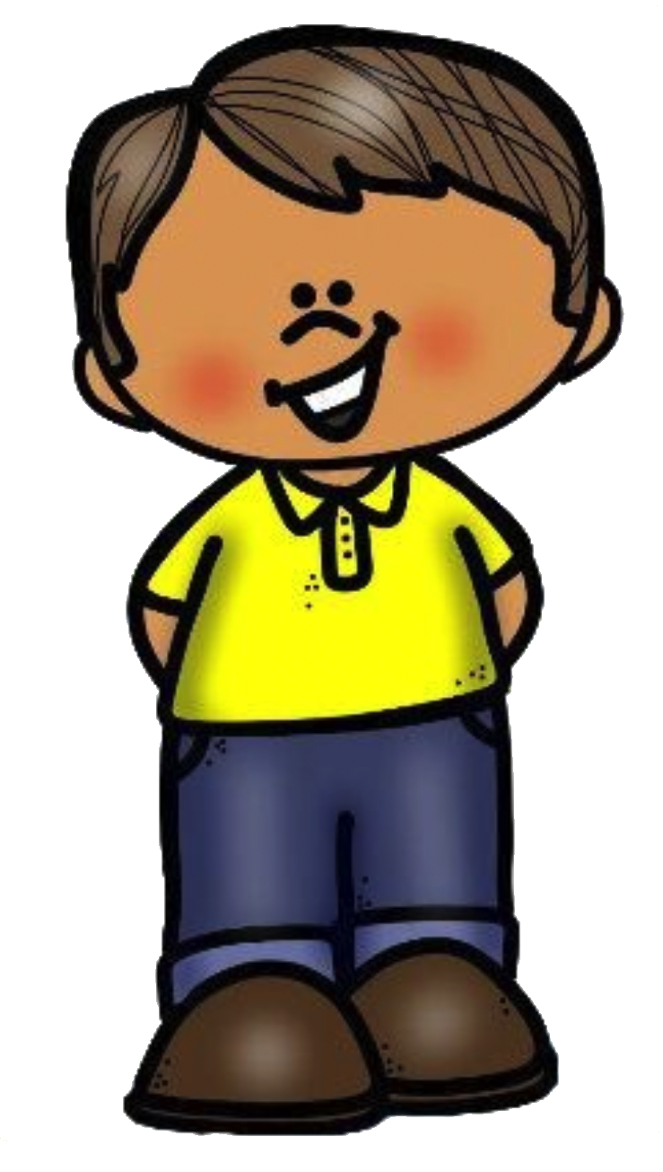
How to Ask for Consent
Notes:
Say, “Great job! Those are some words that we can use to ask for consent or permission. Here are some other examples.” Read any words on the slide that students haven’t mentioned yet.
Say, “What if you really want a hug but the other person doesn’t?” Take some responses, and thank responders for their answers.
Say, “Dealing with rejection is not always easy, but we want to ensure we respect the boundaries of others. What if you’re in the middle of a hug and the person suddenly changes their mind and wants you to let go?” Take some responses, and thank responders for their answers.
Say, “Someone can remove their consent at any time. So if someone wants us to let go, we have to let go. What if the person usually gives you lots of hugs, but today they say no?” Take some responses, and thank responders for their answers.
Say, “It’s totally okay for someone to want a hug one day, but not the next day. We have to respect their wishes, so if they don’t want a hug, we won’t give them a hug.”
With a willing staff member, role play some ways to ask for consent, and demonstrate examples of consent and non-consent. For example:
“Mr. Smith, can I have a high five?” Mr. Smith might say, “Totally!,” and the two of you can high five.
“Ms. Walton, can I have a hug?” Ms. Walton might say, “No thanks!” and you can say, “Okay!” Be sure not to appear offended or sad that Ms. Walton said no. Maintain a neutral facial expression or keep smiling.
“Mr. Williams, can I have a hug?” Mr. Williams says, “Um, okay..." looking and sounding uncomfortable. Instead of giving Mr. Williams a hug, ask students if Mr. Williams really looks like he wants a hug. When students say no, tell Mr. Williams it’s okay not to want a hug, and ask if he’d like a high five instead.
“Ms. King, can I have a hug?” Ms. King might say, “Yes,” but then pull away mid-way through the hug and say, “I don’t want a hug anymore. I changed my mind. Can we just high five?” Then say, “Sure! No problem!” and give Ms. King a high five.
If you would like to show students a video about consent, you can find one here: https://www.youtube.com/watch?v=h3nhM9UlJjc

Slide 6


Body Boundaries
Notes:
Say, “Now let’s talk about boundaries. Has anyone ever heard the word ‘boundaries’? What does it mean?”
Take some responses, and thank responders for their answers.
Then say, “A boundary is an imaginary line that we can’t cross, or can only cross with permission sometimes. Can you think of any examples of boundaries?”
Take some responses, and thank responders for their input. Some possible answers include: lines on a map, out of bounds lines on a sports field, places that adults tell us we can’t go, and our personal space.
If someone mentions personal space, explain that this is the space on and around our bodies that we don’t want anyone to touch, or that other people are not allowed to touch.
Say, “Great job! We all have boundaries. One type of boundaries is body boundaries.”

Slide 7


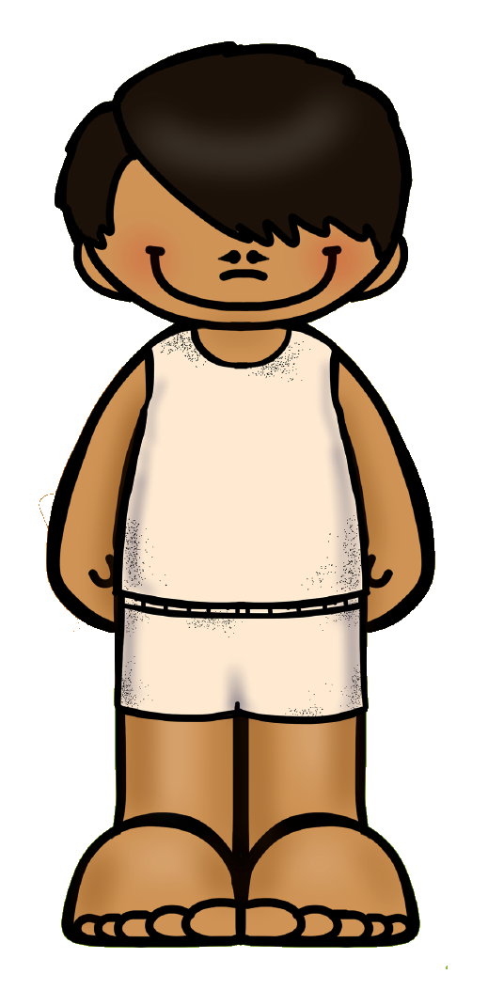
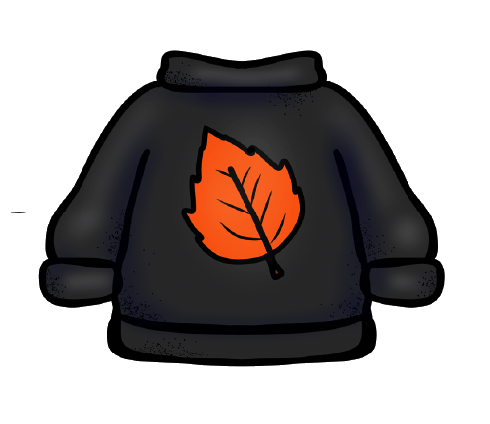



Sam’s Body Boundaries
Notes:
Just click once, and then stop. You should just see an image of a clothed child, without any circles yet.
Say, “This is Sam. What would we say to ask Sam for a high five?”
Take responses, and thank responders for their answers.
Say, “Great job! We might say, ‘Hey Sam, can I have a high five? If Sam says yes, then we can give a high five to Sam. If Sam says no, then we won’t give a high five to Sam. How about if we want a hug?”
Take responses, and thank responders for their answers.
Say, “Great job! We might say, ‘Hey Sam, can I have a hug? If Sam says yes, then we can give a hug to Sam. But there are some parts of Sam’s body that we can’t touch at all. What might those parts be?”
Take responses, and thank responders for their answers. If someone identifies non-private areas, like arms, hands, or head, say, “We would need to ask Sam for consent before touching that, but what are some parts of Sam that we are never allowed to touch, no matter what Sam says?”
Click again, and Sam’s shirt will disappear. Say, “The first area that we can never touch is this area.” Click to see the first circle. Say, “People use different words for this, like chest, breasts, or nipples. No matter what word we use, it’s not okay to touch Sam there. It’s actually not okay for us to touch anyone there! The next area we can’t touch is this area.”
Click again to reveal the second circle. Say, “We all have body parts in this area. We might have a penis, or a vulva and vagina, and some people might use different words like pee pee, wee wee, genitals, private parts, or bathing suit parts. We all have a buttocks, which some people call butt, bottom, patootie, or heinie. There are all different ways that people talk about these body parts, but the important thing is: You can’t touch someone’s body parts this area, ever. It doesn’t matter who they are—friend, classmate, schoolmate, teacher—it’s never okay to touch someone down there. Not even if they think it’s a game. That’s how we respect boundaries!
And if anyone ever touches you there—whether it’s a friend, an adult at school, a family member, or a stranger—you can tell us.”
Note: Students might laugh at the words that describe their body parts, and that’s okay! It’s important that we use the correct terminology, so as to reduce stigma around our bodies, and to give children the terminology they need to tell us if someone touches them. If students laugh the words, say “Naming body parts can make us giggle, because we don’t talk about our bodies very much, and that’s okay! As long as we’re not laughing AT somebody. What’s the difference between laughing AT some body, versus laughing together?” This can be a convenient segue into talking about word boundaries.
Note: If you can also find out the words for these body parts in the predominant languages at your school, that may be helpful for students.

Slide 8
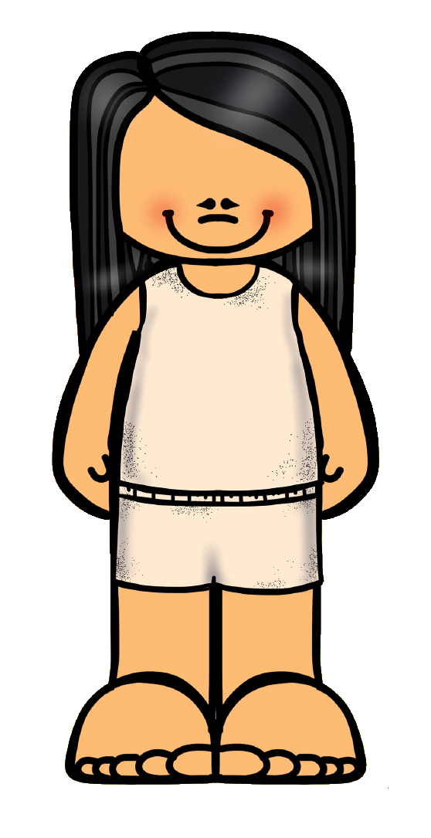



Quinn’s Body Boundaries
Notes:
Just click once, and then stop. You should just see an image of a child, without any circles yet.
Say, “Let’s practice one more time. This is Quinn. What would we say if we want to play tag with Quinn?”
Take responses, and thank responders for their answers.
Say, “Great job! We might say, ‘Hey Quinn, would you like to play tag, or do you want to play tag? If Quinn says yes, then we can play tag with Quinn. But when we tag Quinn, there are some areas that we’re not going to touch. Can you point to the areas?” Allow students to point to the screen.
Click once so that both circles show up. Say, “Great job! We’re not going to touch the areas here. Those are parts of someone’s body that we never touch, no matter what. That’s how we respect boundaries!”

Slide 9

Word Boundaries
Notes:
Say, “Now we’re going to talk about boundaries that we respect with our words.”

Slide 10
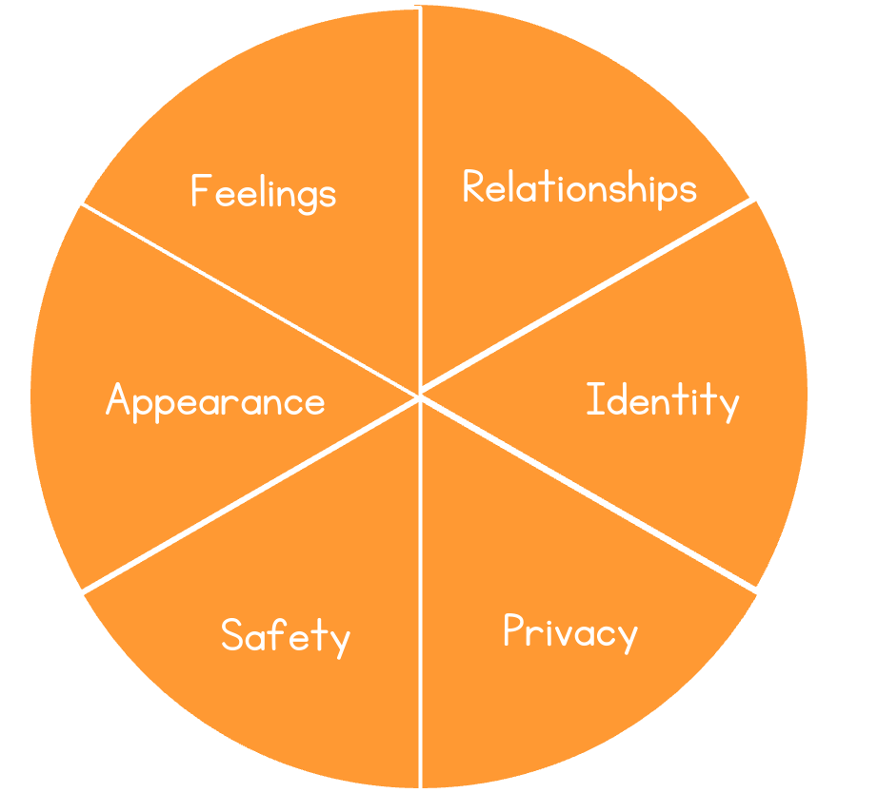
Word Boundary Circle
Notes:
Say, “There are boundaries that none of us should cross with our words. For example, everyone is allowed to have their own feelings, and none of us have the right to judge somebody for their feelings. What are some feelings that people get made fun of for having?”
Take responses, and thank responders for their answers. Some possible responses might include: crying, or feeling scared.
Say, “Great answers. We should never make fun of someone for their feelings, like crying or feeling scared. We should also never make fun of someone for loving or liking someone else. We should also never make fun of someone’s relationships. What are some relationships that someone might have?”
Take responses, and thank responders for their answers. Some possible responses might include: relationship with a friend, relationship with a parent, relationship between two partners.
Say, “Great answers. There are all different kinds of relationships, and we should never make fun of that. We should never make fun of people for being friends, and we should never make fun of people for being a girlfriend, boyfriend, or partner to someone. As people get older, they might get in special kinds of relationships, and that can happen no matter who they are. Boys can be in relationships with boys, girls can be in relationships with girls, boys and girls can be in relationships together. If we make fun of someone’s relationships, we’re crossing their boundaries.
People might use different words to describe who they like to be in special relationships with—words like lesbian, gay, bisexual, and straight. These are all words that can describe their identity, or a way that someone thinks about themselves or feels is a part of themselves. Also, people might identify as a girl, a boy, or neither, and that’s another one of their identities. We should never make fun of someone’s identity. That would be crossing their boundaries.
People are also entitled to privacy. What do I mean when I say privacy?”
Take responses, and thank responders for their answers. Some possible responses might include: privacy when we get dressed, privacy when we go to the bathroom, and privacy for our secrets.
Say, “Great answers. Privacy just means that we respect the things that people don’t want us to hear, see, or share with anyone. For example, we should never tell others about who someone has a crush on, or share information about someone’s identity without their consent. We also shouldn’t share pictures that people don’t want us to share of them. And we shouldn’t make things up about people either. These would all be crossing someone’s boundaries.
We are all also entitled to safety. We should never make anyone feel unsafe. What are some things someone might say to us that would make us feel unsafe?”
Take responses, and thank responders for their answers. Some possible responses might include: telling someone we’re going to hurt them, or that we’re going to cross their body boundaries.
Say, “Great answers. If we tell someone that we’re going to hurt someone, or that we’re going to cross their body boundaries, even if it’s in a text message or online post in social media. that could make someone feel really unsafe. That would be crossing someone’s boundaries.
Lastly, we’re all beautiful inside and out. The way that we look is called our appearance, and we all look different in our own fantastic ways. We should never make fun of the way that someone looks. How might it make us feel if someone makes fun of the way we look?”
Take responses, and thank responders for their answers. Some possible responses might include: sad, bad, or mad.
Say, “Great answers. When someone makes fun of our appearance, that can really hurt. It can also hurt if someone talks badly about our body parts, including the body parts we talked about earlier, like our genitals or breasts or buttocks. Making fun of those would be crossing someone’s boundaries, and it’s not okay.”
For 4th and 5th grade students:
If you are presenting to 4th and 5th grade students alone, you can give more specific examples that they might deal with. For example, unwelcome sexual or love notes, unwelcome sexual drawings or text messages.

Slide 11
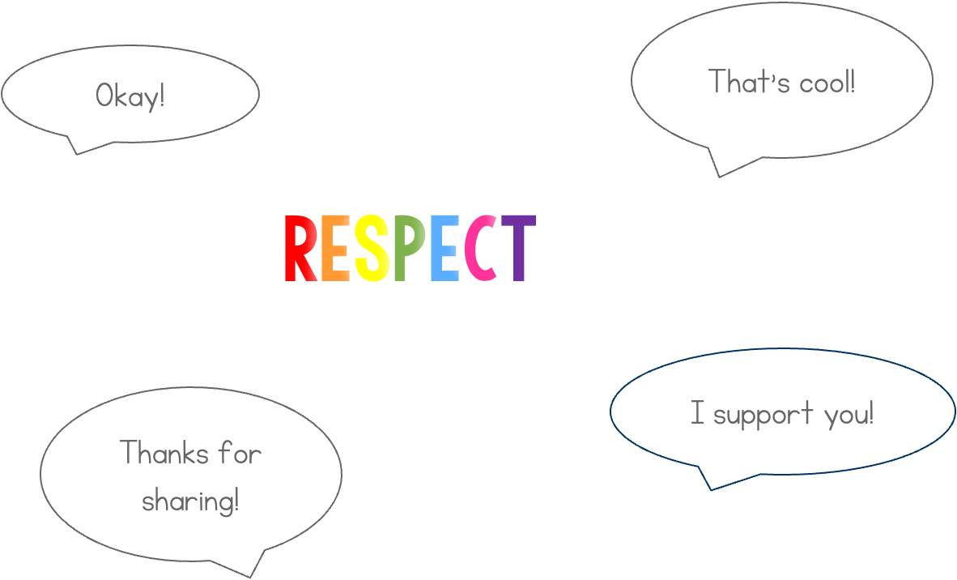
Respectful Words
Notes:
Say, “The best way not to cross anyone’s word boundaries is to respect and support each other. What are some respectful things we can say if someone tells us they’re feeling sad or scared?”
Take responses and thank responders for their answers. Possible responses might include It’s okay, I’m here for you, or thanks for sharing.
Say, “Great! When someone tells us they’re sad, we can say, ‘It’s okay, I’m here for you,’ or ‘Thanks for sharing!’ We can also say, ‘Maybe you can talk to an adult about your feelings.’ What are some things we can say if someone tells us how they identify? Like if they say they’re a boy or a girl, or gay or straight?”
Take responses, and thank responders for their answers. Possible responses might include: That’s cool, thanks for sharing, and I support you.
Say, “Great! When someone tells us how they identify, we can say, “That’s cool, thanks for sharing,” and “I support you! And what are some respectful things we can say if we ask for a hug and they say no?”
Take responses, and thank responders for their answers. Possible responses might include: It’s cool, or no problem.
Say, “Great! We can say, ‘Okay!’ or ‘No problem!’”

Slide 12


Sexual Harassment
Touching someone without consent
Crossing someone’s body boundaries
Crossing someone’s boundaries with our words
Notes:
Note to teacher: student-to-student sexual harassment is unwelcome conduct and/or communication of a sexual nature by a student directed against another student. Such behavior can constitute sexual harassment regardless of the gender, sexual orientation, gender identity, or gender expression of any of the students involved. Sexual harassment may be a single incident or a series of related incidents.
Student-to-student sexual harassment may take many forms. It may be verbal, nonverbal, physical, written, or electronically communicated (including during online learning). Electronically communicated harassment includes communications via technology including, but not limited to internet; cell phone; email; personal digital assistant; texting; apps; wireless handheld device; social media; chat rooms; gaming systems; and blogs.
It is a violation of A-831 for a student to harass another student through unwelcome conduct or communication of a sexual nature which is sufficiently severe, pervasive, or persistent as to either: (1) create a hostile, offensive, or intimidating school environment for another student by conduct that: a. has or would have the effect of unreasonably and substantially interfering with a student’s educational performance, opportunities, or ability to participate in or benefit from an educational program (e.g., the student is not regularly attending classes; the student’s academic performance or performance in class has changed), school-sponsored activity or any other aspect of a student’s education (e.g., the student is no longer regularly attending extracurricular activities or level of participation is changed); or b. has or would have the effect of unreasonably and substantially interfering with a student’s mental, emotional, or physical wellbeing (e.g., the student’s behavior in school is impacted; the student is withdrawn or isolating themselves; the student appears to be anxious, depressed, or distracted); or c. reasonably causes or would reasonably be expected to cause a student to fear for their physical safety (e.g., the student and/or other students or staff have expressed concerns about the student’s safety); or d. reasonably causes or would reasonably be expected to cause physical injury or emotional harm to a student. OR (2) otherwise adversely affects a student’s educational opportunities
--
Say, “All of the things that we’re talking about could be sexual harassment. If someone touches us without consent, that could be sexual harassment. Remind me, what does consent mean?”
Take responses, and thank responders for their answers. The correct response is that consent is permission to do something.
Say, “Great answer. Consent is just permission to do something. But are there some parts of people’s bodies that no one can touch, no matter what?”
Students will likely shout “yes.”
Say, “Good job. Our genitals, breasts, and buttocks are areas that no one can touch no matter what. And there are also boundaries that we shouldn’t cross with our words, right? What are some examples of those boundaries?”
Take responses, identify correct responses, and encourage incorrect responders to try again. Possible responses are: making fun of someone’s feelings, making fun of someone’s relationships, making fun of someone’s identity, violating someone’s privacy, threatening someone’s safety, and making fun of someone’s appearance.
Say, “Great answers. If we don’t respect someone’s feelings, relationships, identity, privacy, safety, and appearance, we might be crossing their boundaries. When we cross someone’s boundaries with our words, especially if we’re talking about who someone has a crush on, or talking about their genitals, breasts, or buttocks, that could be sexual harassment.
All of the things we talked about today—touching someone without consent, crossing someone’s body boundaries, and crossing someone’s boundaries with our words, could be sexual harassment. Sexual harassment is hurtful and wrong no matter where you are—whether it’s at school, or outside of school. If someone does these things to you, you can tell an adult at school so that we can keep you all safe.
Say, “If someone tries to stop you from telling an adult, or if an adult ever refuses to help you, that can be retaliation (revenge or payback). Retaliation is not okay. If anyone ever retaliates against you, you can tell another adult, and we will help you.”

Slide 13




Feelings
Notes:
Say, “How might someone feel when they are sexually harassed?”
Take responses, and thank responders for their answers. Possible responses might include: bad, sad, unsafe, dirty, confused, hurt
Say, “Great answers. Sexual harassment can make someone feel all different ways—sad, mad, unsafe. Someone might even have trouble feeling any way at all.
When we’re feeling sad, or mad, or unsafe, what can happen to us?”
Take responses, and thank responders for their answers. Possible responses might include: don’t want to talk to your friends, can’t do homework, don’t want to eat
Say, “Great answers. When we’re feeling bad, we might have trouble eating, sleeping, hanging out with friends, or doing schoolwork.
If you ever feel like that, tell a trusted adult. We’re here to support you, and we can help you to feel better.
The reason we need to respect people’s boundaries and use kind words is because sexual harassment can hurt.”

Slide 14

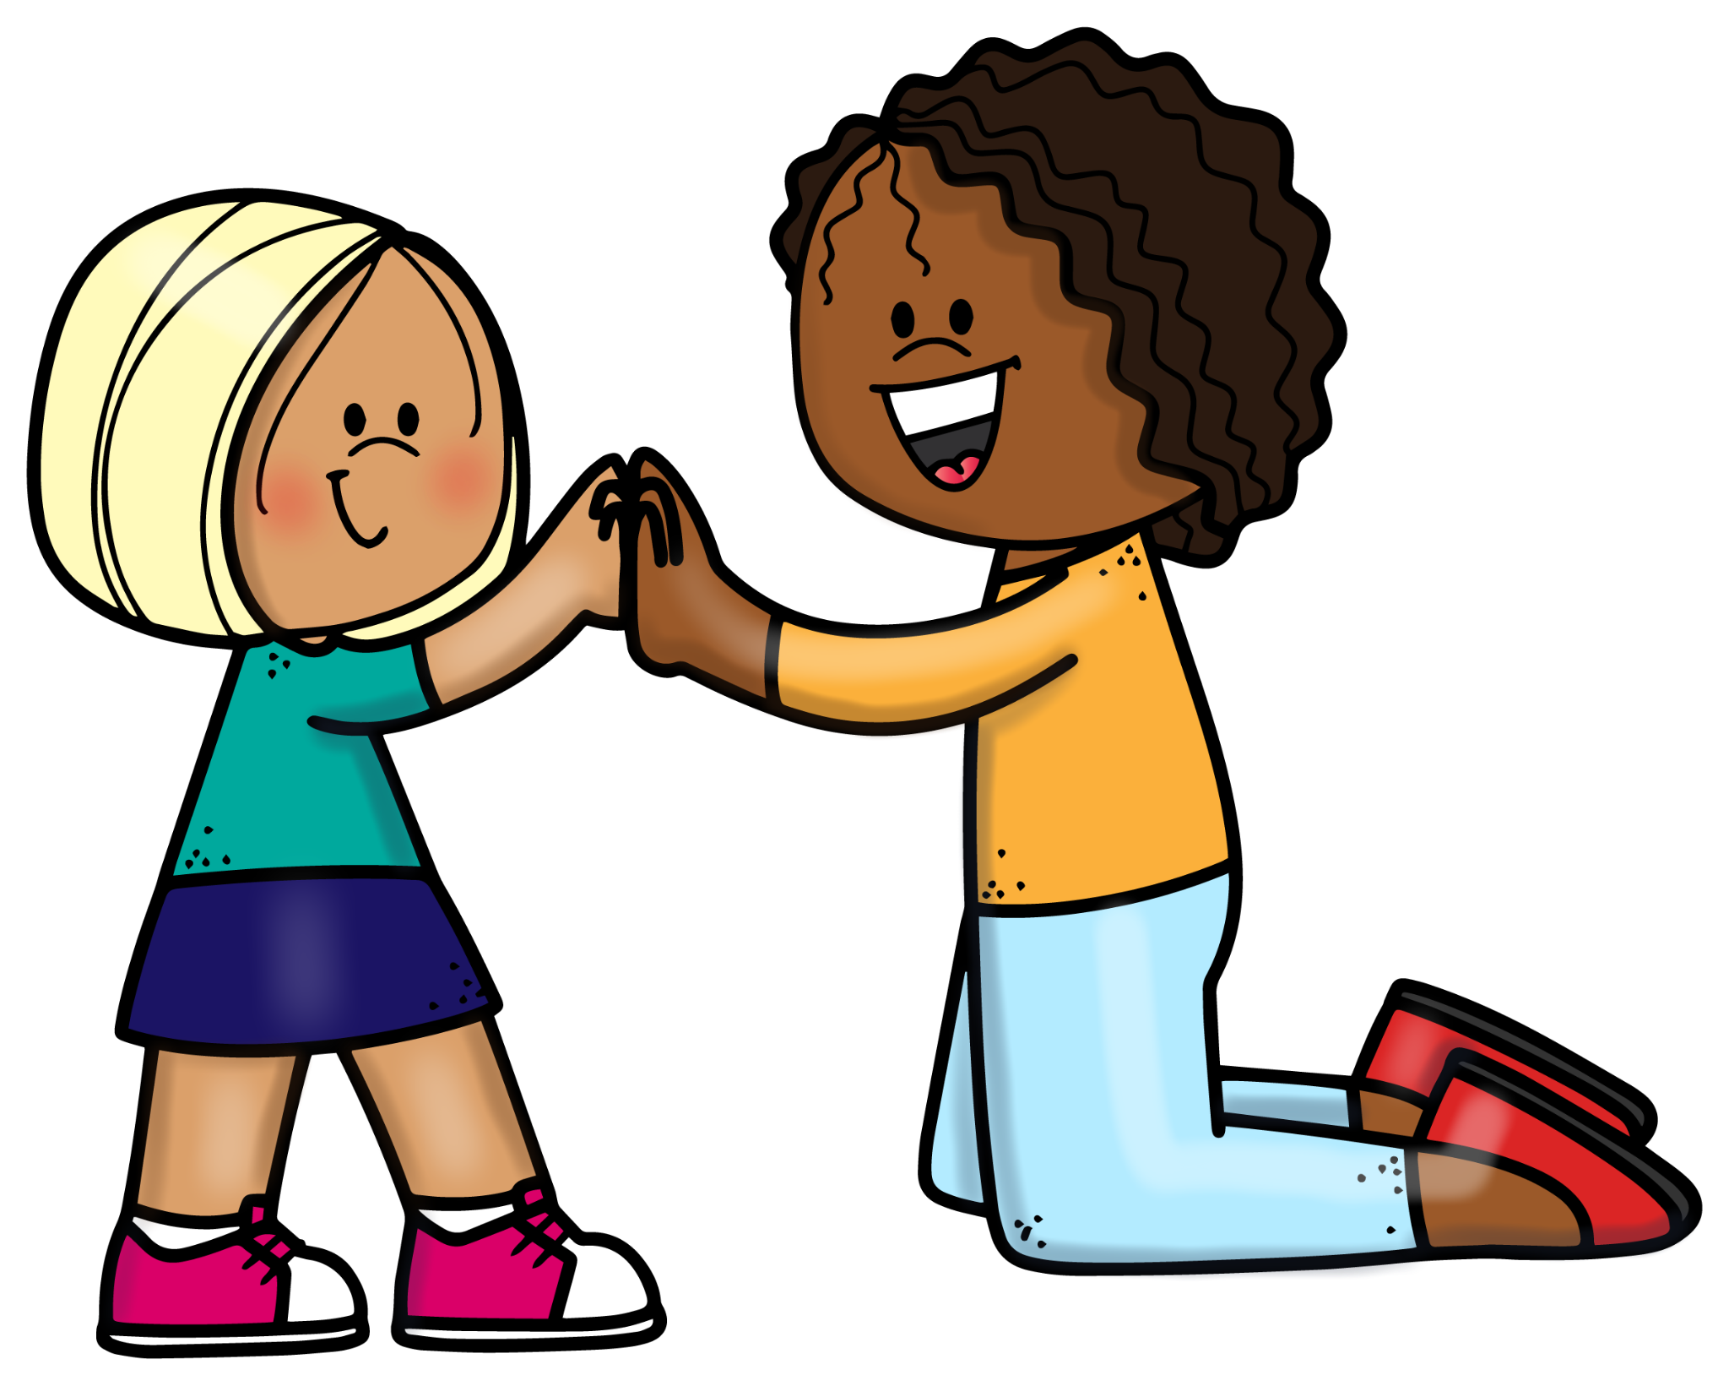

Helping Friends
Notes:
Say, “Now let’s talk about how to help friends.
If we see Andy cross Blair’s boundaries, what can we do?”
Take responses, and thank responders for their answers. Say, “Great answers! There are all different ways that we can help our friends. Let’s talk about three of them.
[Click.} Say “One way to help our friends is to ask if they’re okay.”
[Click.] Say, “Another way to help our friends is to tell the person harassing them to stop. You can say, ‘That’s not nice! Stop doing that.’”
[Click.] Say, “Another way to help our friends is to tell a school staff person, like a teacher or a principal or a counselor.
The best way to help a friend is to do all three of these things!”

Slide 15
Telling Adults
You can tell any adult at school
They will tell ___________
We will call parents/guardians for support
We will ask questions to find out what happened
We will take steps to keep you safe
We will take steps to stop the harassment
Notes:
Note to the teacher: the principal/designee will ask the victim and the accused to prepare their witness statements during the investigation and may refer the student(s) to the school social worker, guidance counselor, psychologist, or other appropriate school staff as examples of “guidance interventions.” “Referral to in-school or out-of-school medical services” as a support or intervention under A-831 and/or A-832.
Before facilitating this slide, you must find out who your trained Sexual Harassment Prevention liaison is and insert their name.
Say, “If any of these things happen to you, you can tell any adult in the school. That adult will tell _______ because that person is specially trained to handle this. We will have to talk to students or staff who may have seen or know about what happened. We can also call your parents, so that they can help support you. If you are uncomfortable or upset about us telling your parents or talking with others, please be sure to tell us so that we can talk about it with you. Also, if anyone starts to treat you differently or makes you feel badly because you came to us and told us, please let our Sexual Harassment Prevention liaison know.
Even if you don’t tell us who harassed you, we will still try to help.
Once we know the full story, we’ll take steps to keep you safe. That might mean that you can talk more with the school counselor or talk to someone at an outside organization who understands what you’re going through. It might also mean that we’ll move people to different seats or classes to make sure that the harassment stops. No matter what, we have to make sure that the harassment stops.
It can be really hard to tell adults when someone crosses your boundaries, but just know that we are here to support you, and you will never get in trouble for telling us if someone else crosses your boundaries, even if it can feel scary to say it out loud. We’ll do everything we can to help make you feel better.”

Slide 16
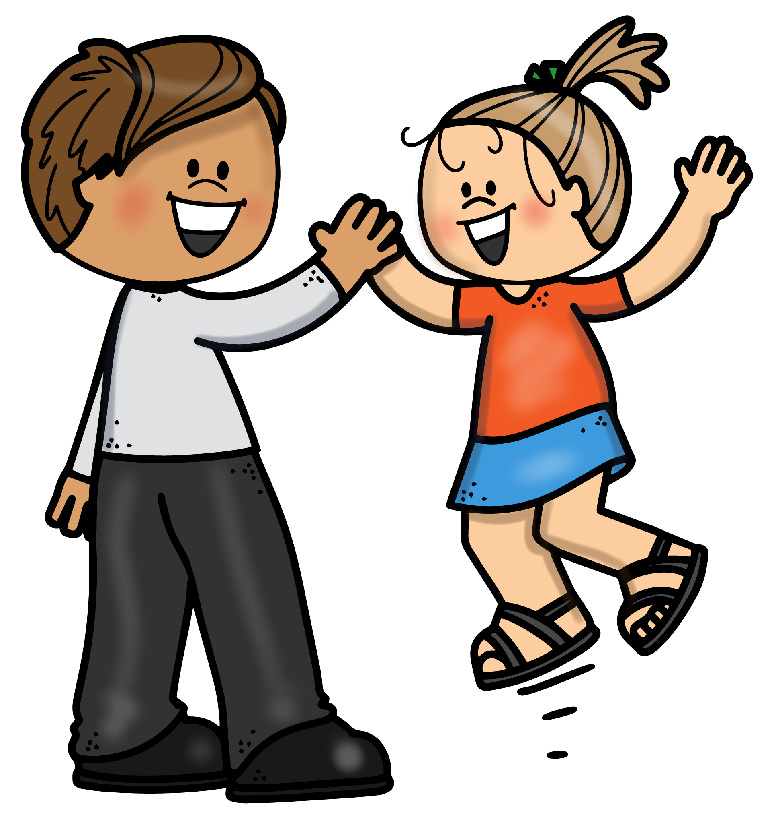
Telling Adults
Notes:
Say, “How does it feel when we tell our parents or guardians that you’re hurt or sad?”
Take responses, and thank responders for their answers. Possible responses might include: good, bad, happy, scary, etc.
Say, “Great answers. Sometimes it might feel good to tell your parents or guardians how you feel. But sometimes you might feel worried or nervous or scared. That’s okay. Let a trusted adult at school know. If we know that you’re feeling this way, we can be more careful when we talk to your parents. We also may be able to help you feel more comfortable talking to them.
What if another student is making fun of you for something private--something that even your parents or guardians may not know about you. Would you be scared to tell your parents or guardians about it? Would you be worried if they found out?”
Students will likely nod their heads, yes.
Say, “It can be a little scary for your parents or guardians to find out something private about you. But sometimes once you tell them, they can help to keep you safe and supported. If you’re worried about your parents finding out something private about you, let us know, and we can be more careful when we talk to your parents or we can help you talk to them.”

Slide 17




Other Ways to Tell Adults
Write it down on paper or the Student and Parent Complaint/Reporting Form and hand it to an adult
Email Respectforall@schools.nyc.gov or Title_IX_Inquiries@schools.nyc.gov
Go to https://www.nycenet.edu/bullyingreporting
Email ocr.NewYork@ed.gov or go to ed.gov/ocr
Notes:
Note to the teacher: students, parents, and individuals other than staff may report allegations of student to-student sexual harassment verbally or in writing, including by submitting the Complaint/Reporting Form (available at https://www.schools.nyc.gov/docs /default-source/default-document-library/student-complaint-reporting-form), to the principal/designee, SHP liaison, or any other school staff member, notifying the Title IX Coordinator (by phone, email, or in person via the information listed in Section IX below), or via the online portal (available at https://www.nycenet.edu /bullyingreporting).
Title IX Coordinator 65 Court Street, Room 200 Brooklyn, NY 11201 Email: Title_IX_Inquiries@schools.nyc.gov Telephone: (718) 935-4987
Say, “Sometimes it can be hard to tell someone in person, and easier to say it in an email or in writing. If you want to write down what happened to you and hand it to an adult at school, that’s okay too!
Also, if you want to email someone that works in the safety office for our school district, you can email respectforall@schools.nyc.gov, and the safety office will work with us to help you.
You can also email Title_IX_Inquiries@schools.nyc.gov if you ever feel like the school isn’t doing enough to help you.
If you want to go online and type your report in, you can do so at https://www.nycenet.edu/bullyingreporting. An adult can help you write down or email your report or submit online if you want or need help!
The federal government has an office that can help, called the Office for Civil Rights. You can report to them by emailing ocr.NewYork@ed.gov or by going to ed.gov/ocr.
That’s all for our presentation today. Does anyone have any questions they want the whole group to hear?”
Allow time for questions.
Say, “Thanks for being such great participants today! It can be difficult to talk about this topic. If you want to talk privately with an adult, I will stay here after everyone leaves, and you are welcome to come talk to me. Thank you!”

Slide 18
Other Ways to Learn More
Frequently Asked Questions (FAQ)
(https://www.schools.nyc.gov/docs/default-source/default-document-library/student-to-student-discrimination-sexual-and-other-harassment-intimidation-bullying-faq)
This resource for parents and students includes helpful information about how to report A-831 and/or A-832 incidents, the investigation process, and follow-up actions that are required under the regulations to prevent and address student-to-student sexual harassment and student-to-student gender-based harassment, bullying, intimidation, and/or discrimination. You can ask your school how to get a copy.

