Slide 1


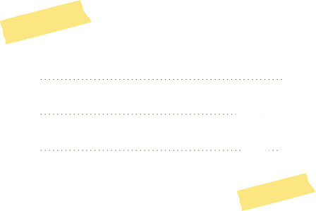

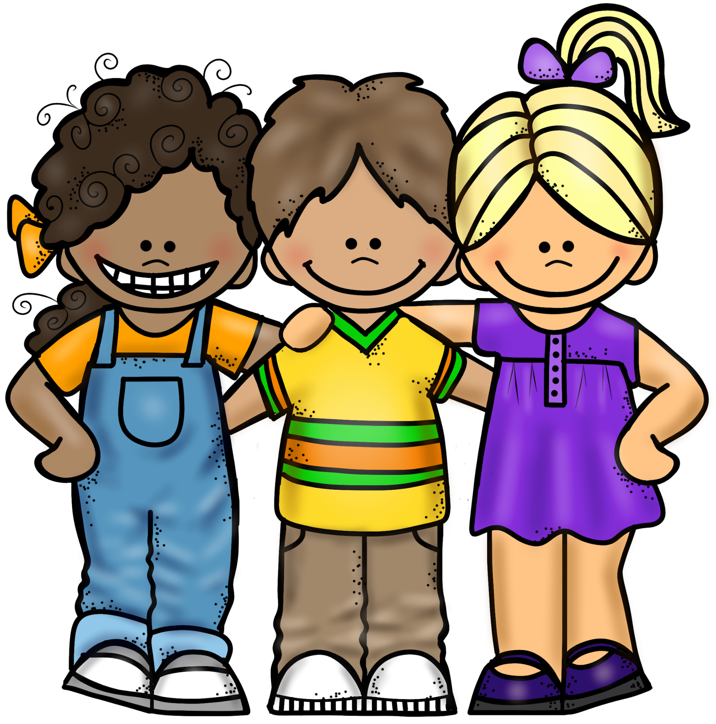
My School Rules
Student Code of Conduct Student Presentation
October 2, 2023
Companion to the Discipline Code for Grades K-3
Office of Safety and Youth Development
Mark Rampersant
Senior Executive Director
September 2019

Slide 2

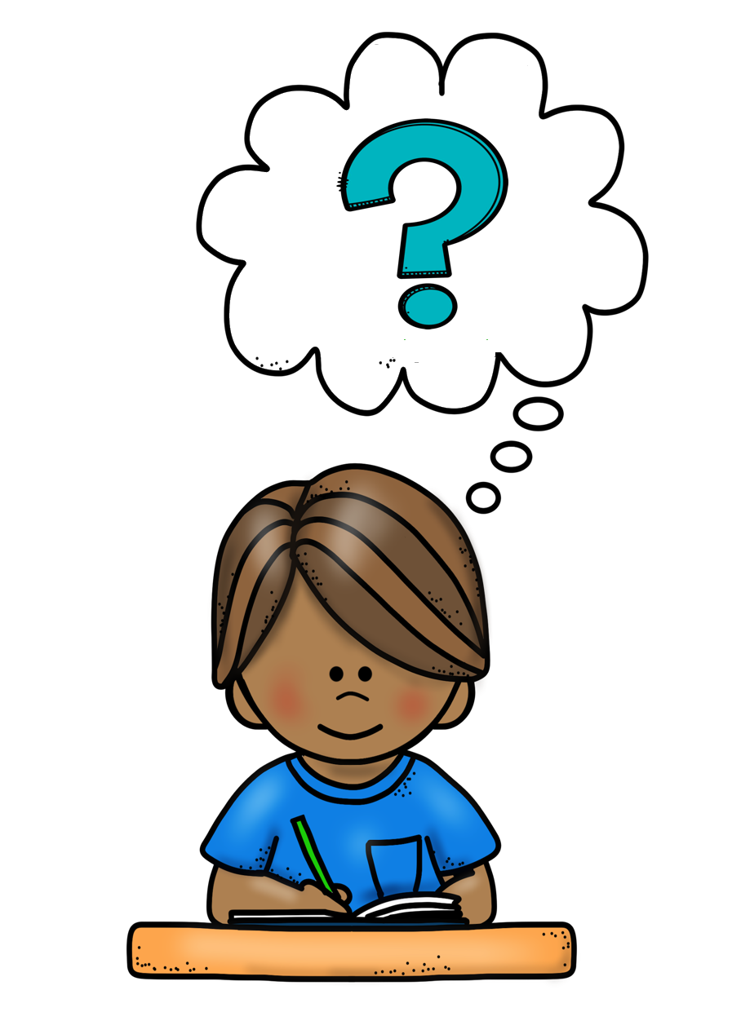



Why am I at school?
Notes:
Establishing the purpose of school and how it is different from other places.

Slide 3
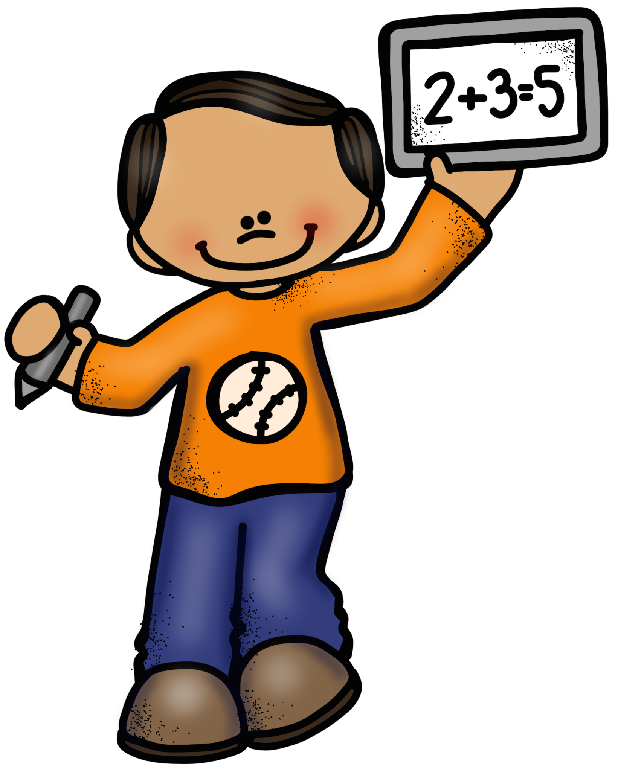
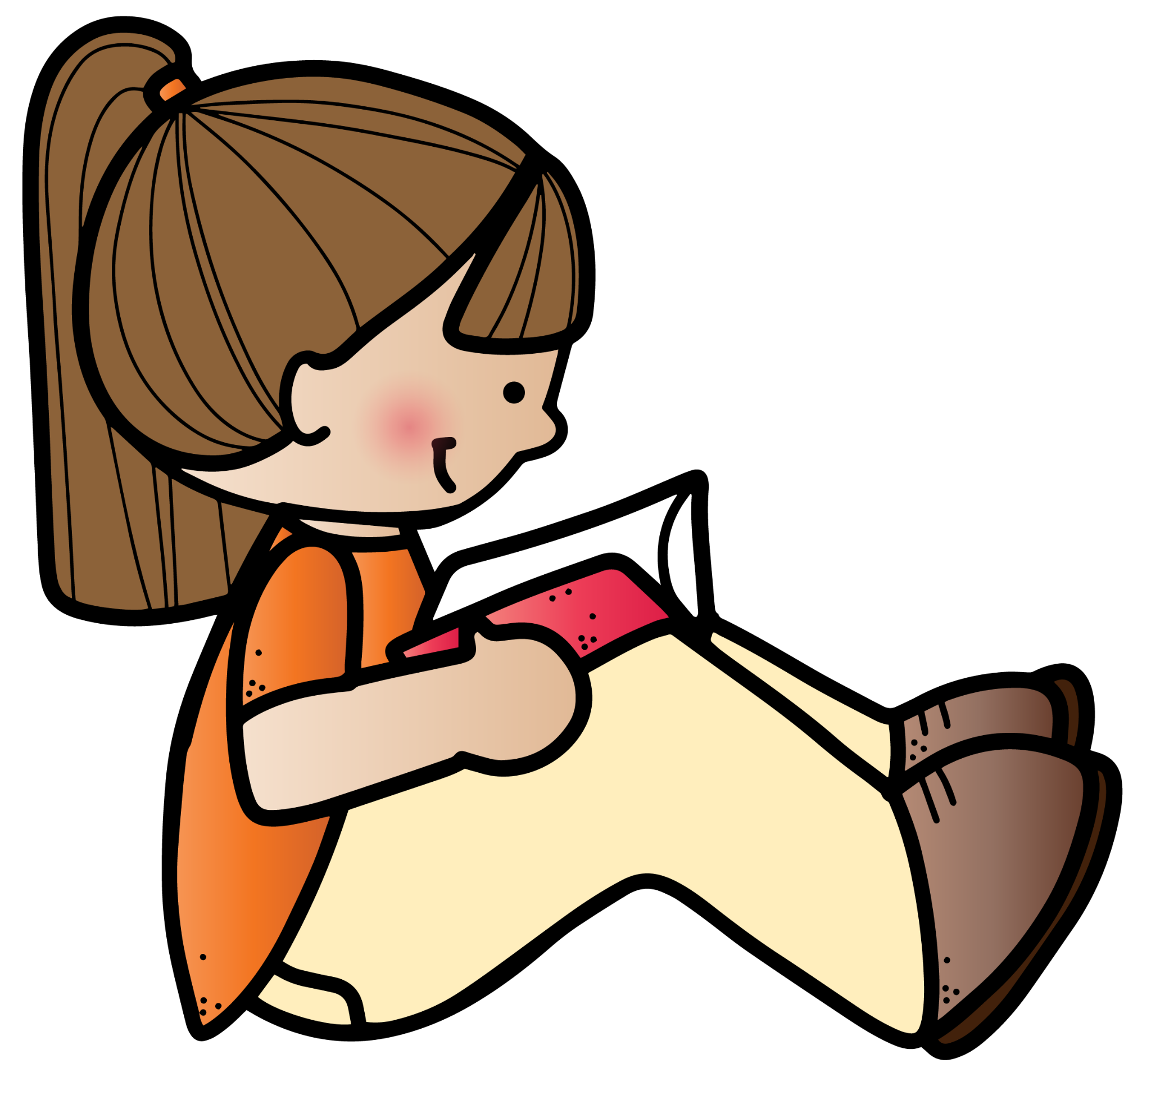
I am here to learn
Notes:
What types of things are we here to learn?

Slide 4
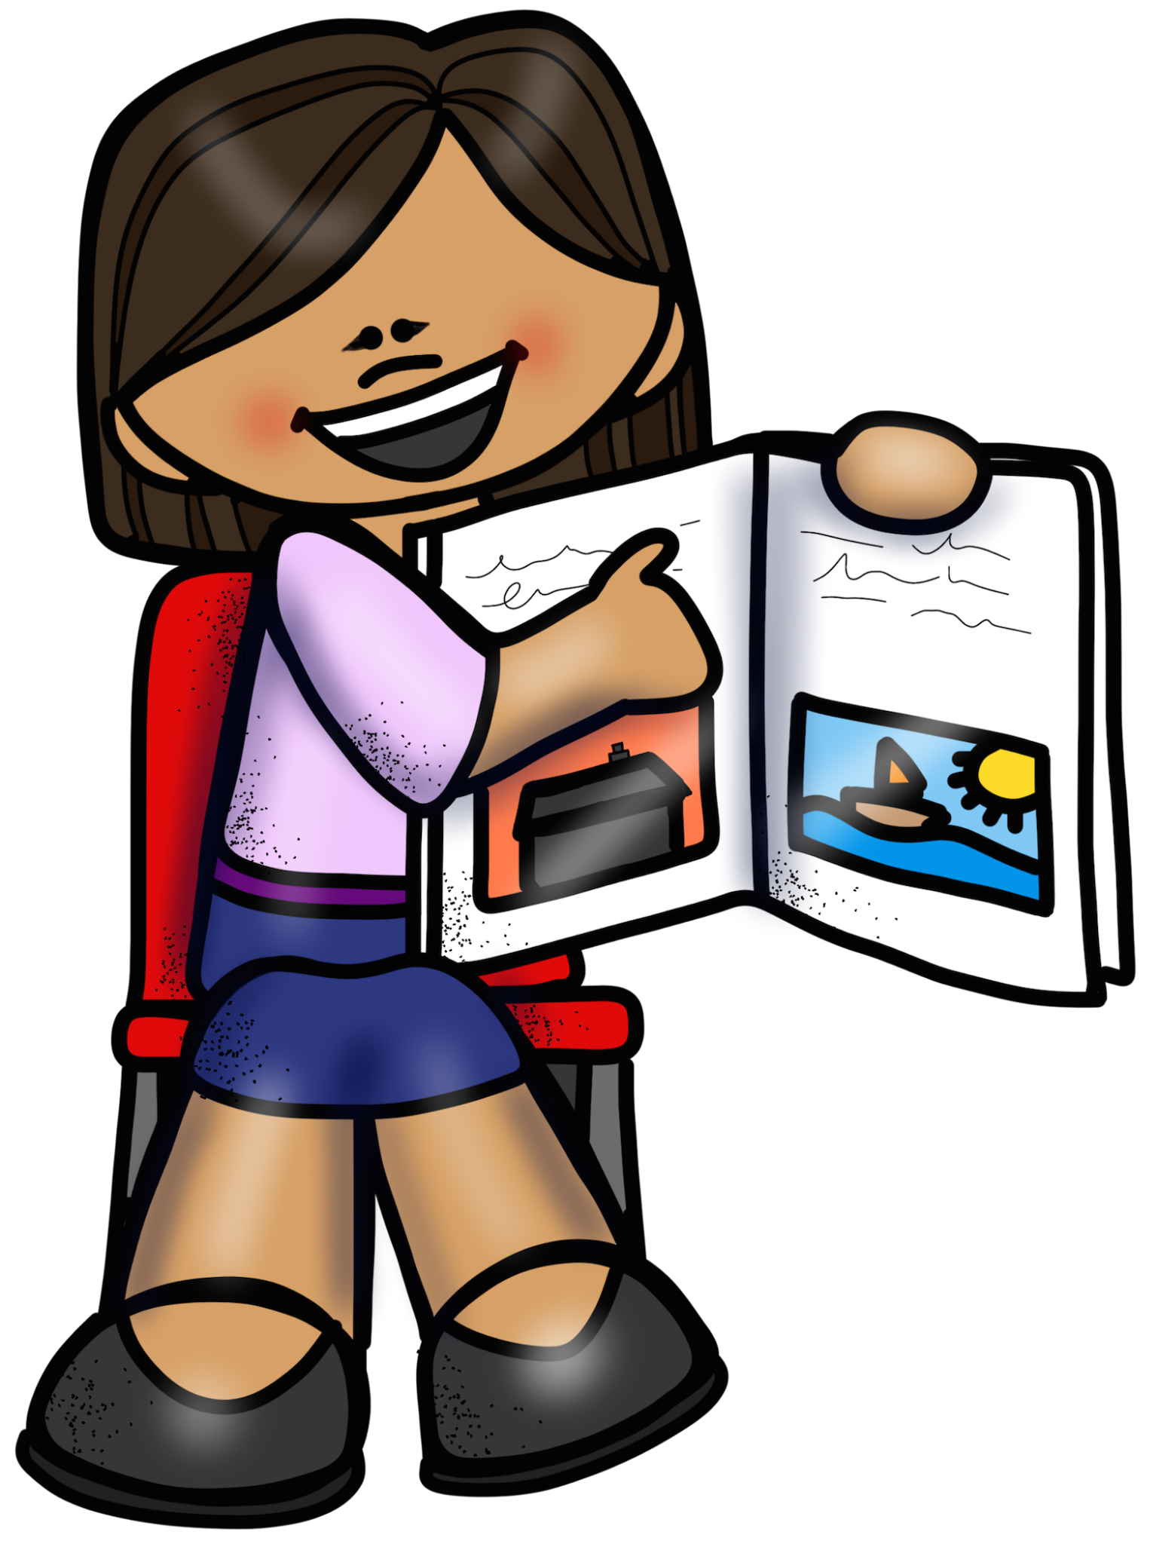
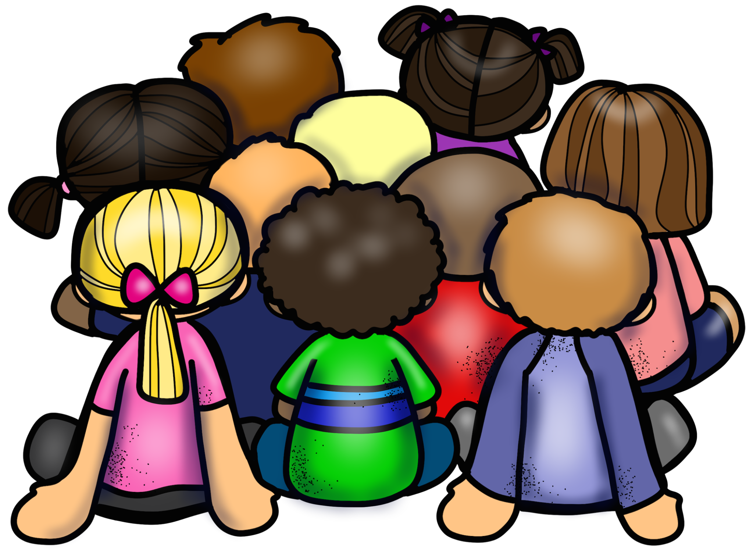
We are all here to learn
Notes:
So all of you are here for the same reason. Establishing a sense of community. Not just “me” but “we.”

Slide 5


While I am in school
I should be safe
We should ALL
be safe
Notes:
What does safe mean?

Slide 6
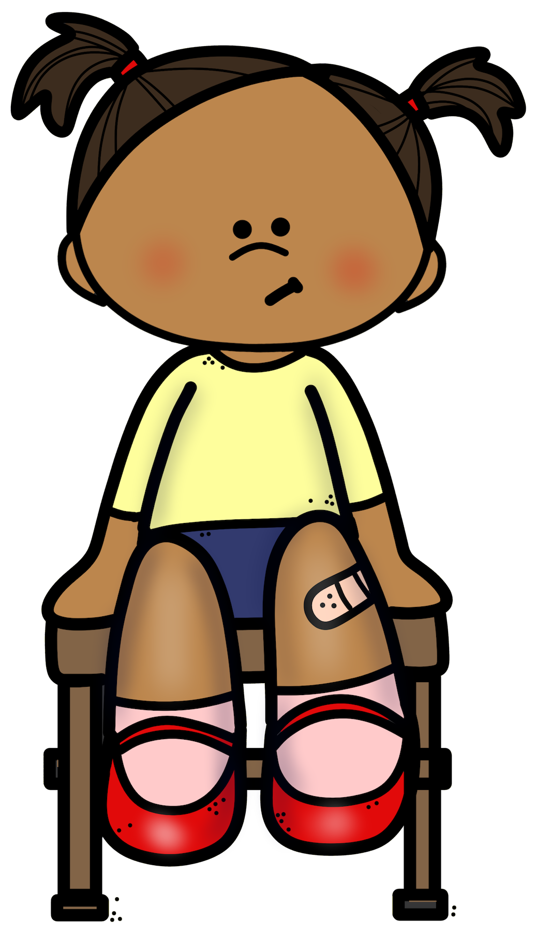
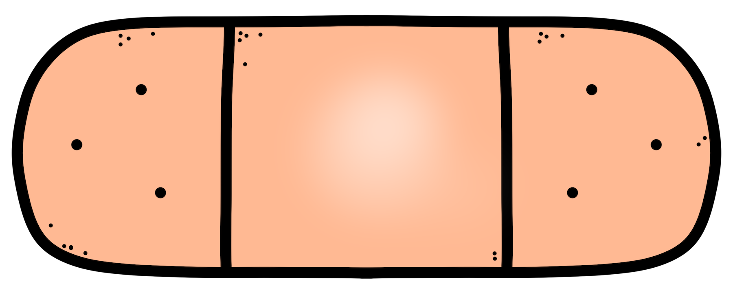



What Does “Safe” Mean?
Nobody’s heart gets hurt
Nobody gets hurt
Notes:
Ask for examples of how a body can get hurt. Ask for examples of how a heart (feelings) can get hurt.

Slide 7

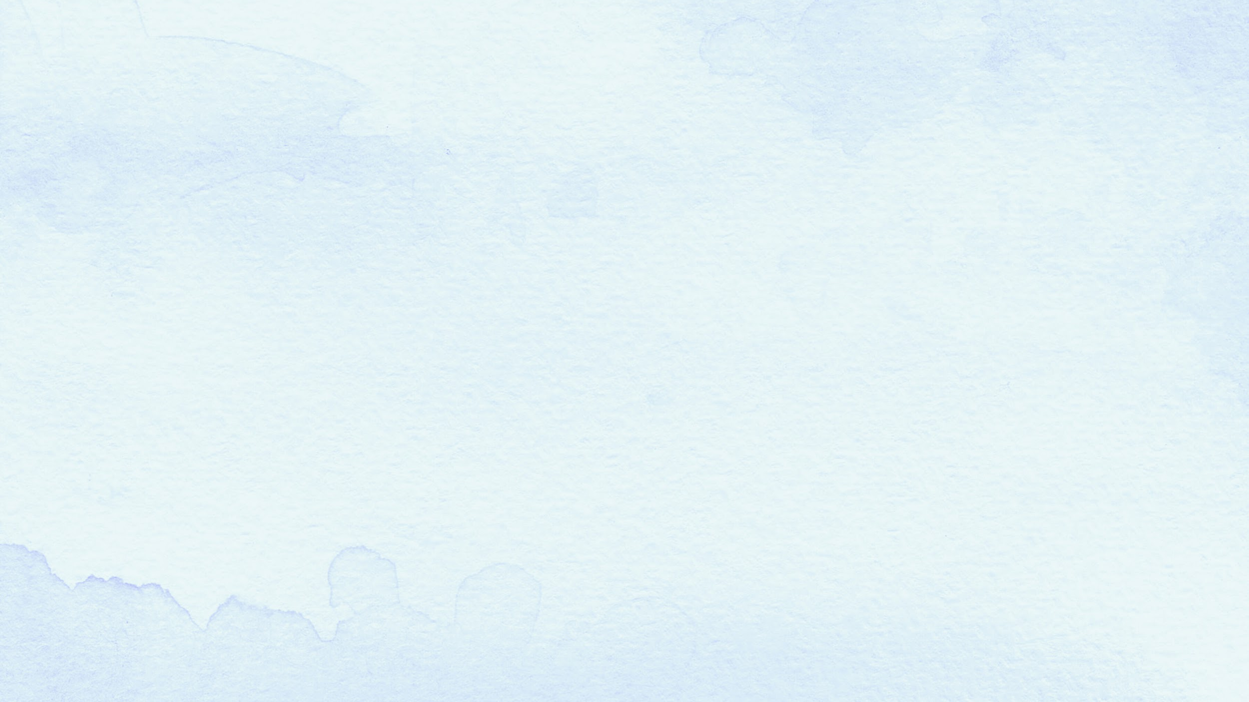


A Story…Scrappy the Squirrel
Once upon a time there a was a squirrel named Scrappy.
Scrappy did whatever he wanted...whenever he wanted.

Slide 8
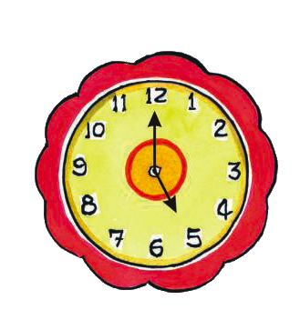
He ate when it wasn’t time to eat…

Slide 9

Scrappy even ate other squirrel’s food…

Slide 10
Scrappy ran around whenever he wanted
Bumping into things and into other animals

Slide 11
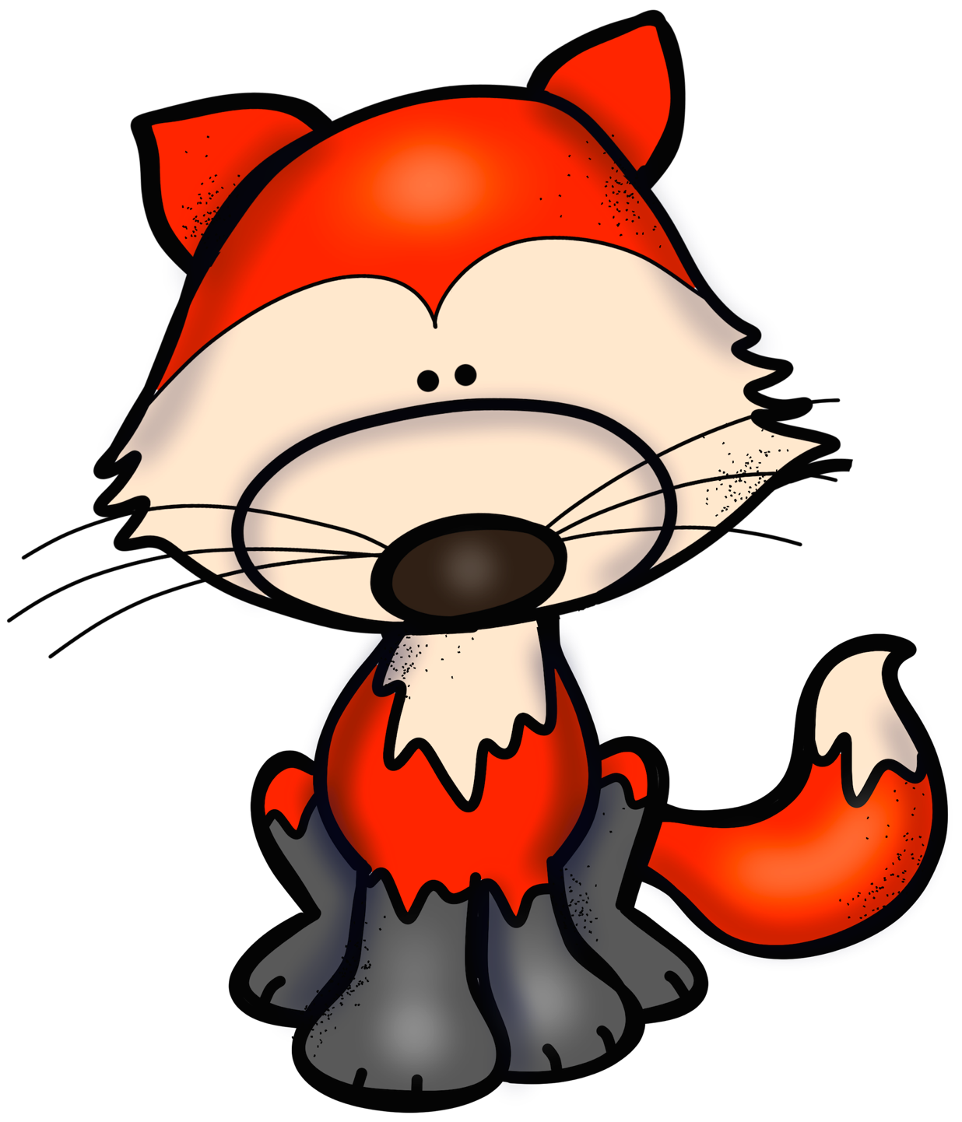
Scrappy ran around whenever he wanted
Bumping into things and into other animals

Slide 12
Scrappy did whatever he wanted…
…whenever he wanted

Slide 13
Let’s talk about it…
What do you think about how Scrappy acted?
How would you feel if he took your food?
How would you feel if he bumped into you?
What would help to make things better?

Slide 14
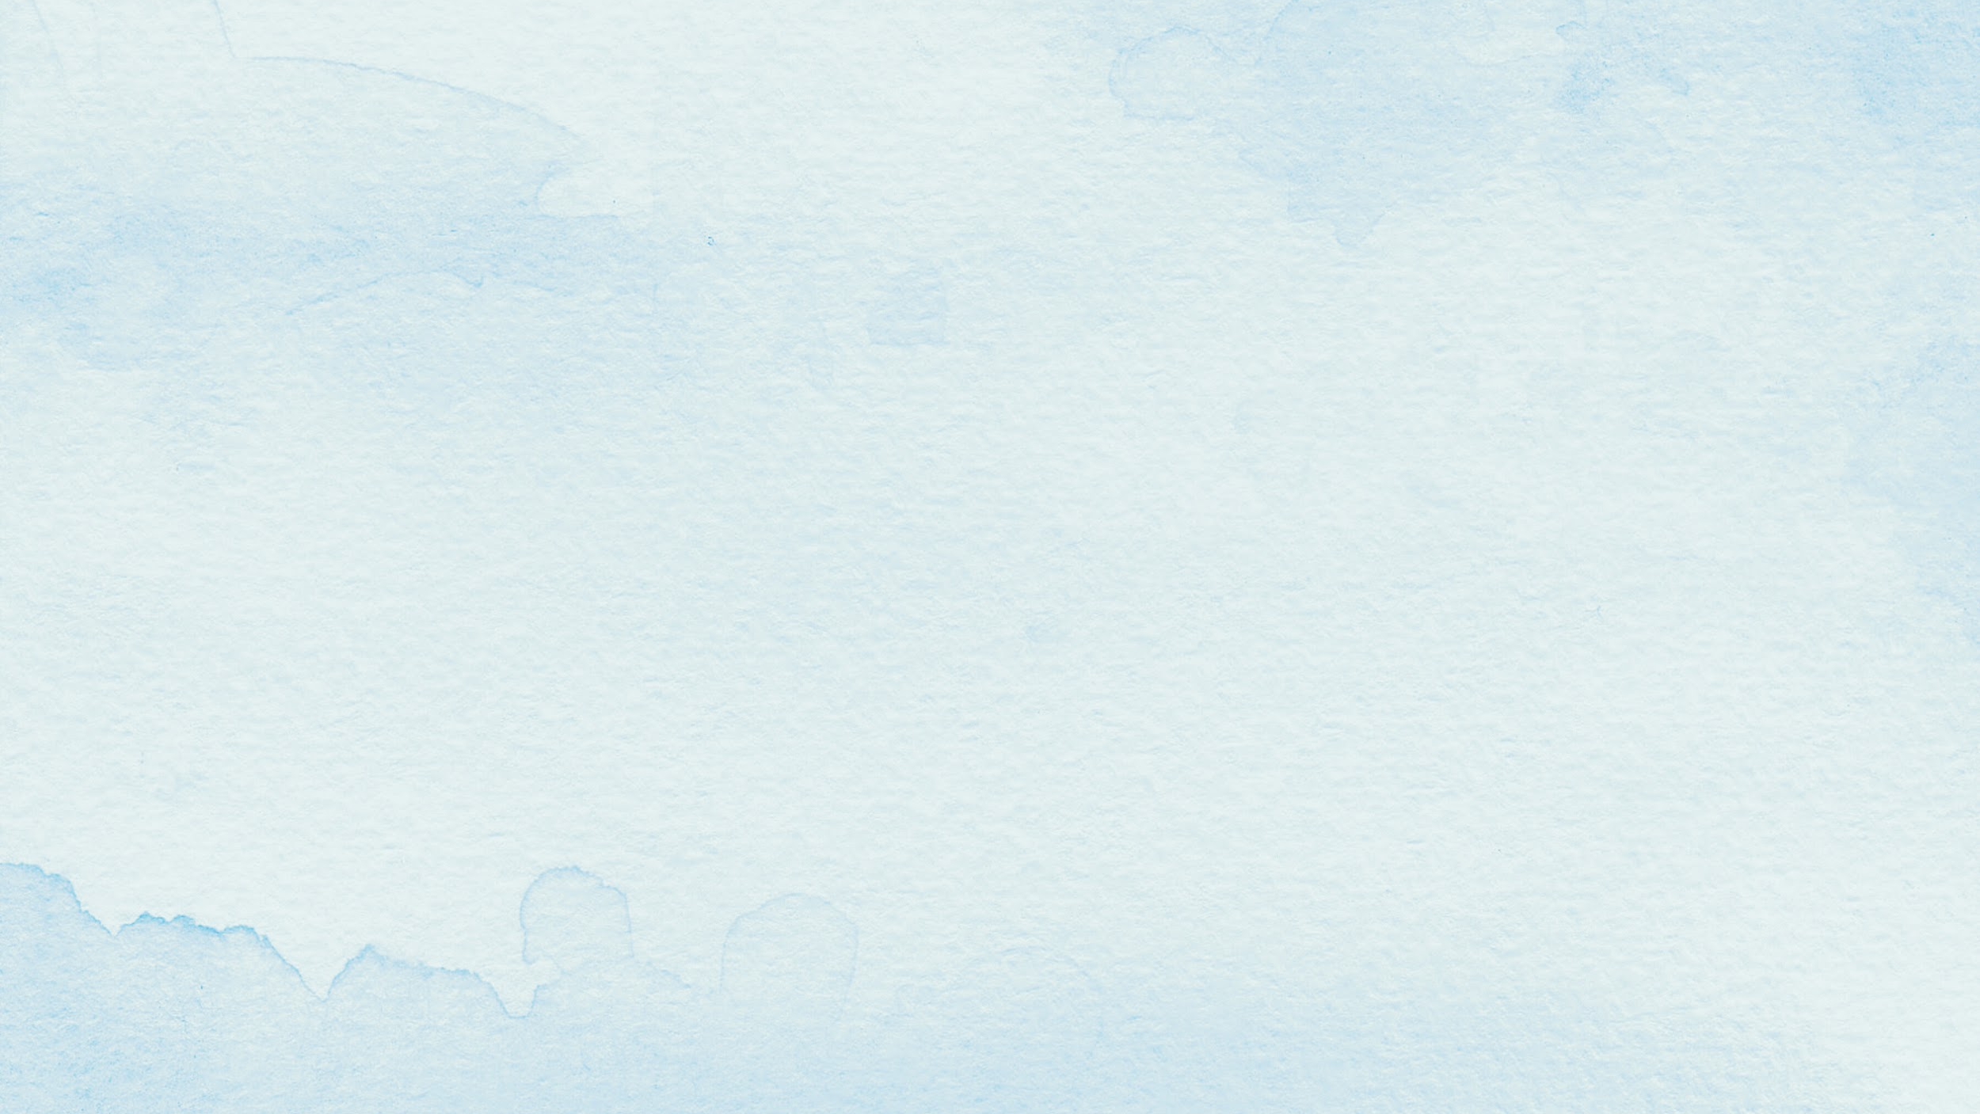

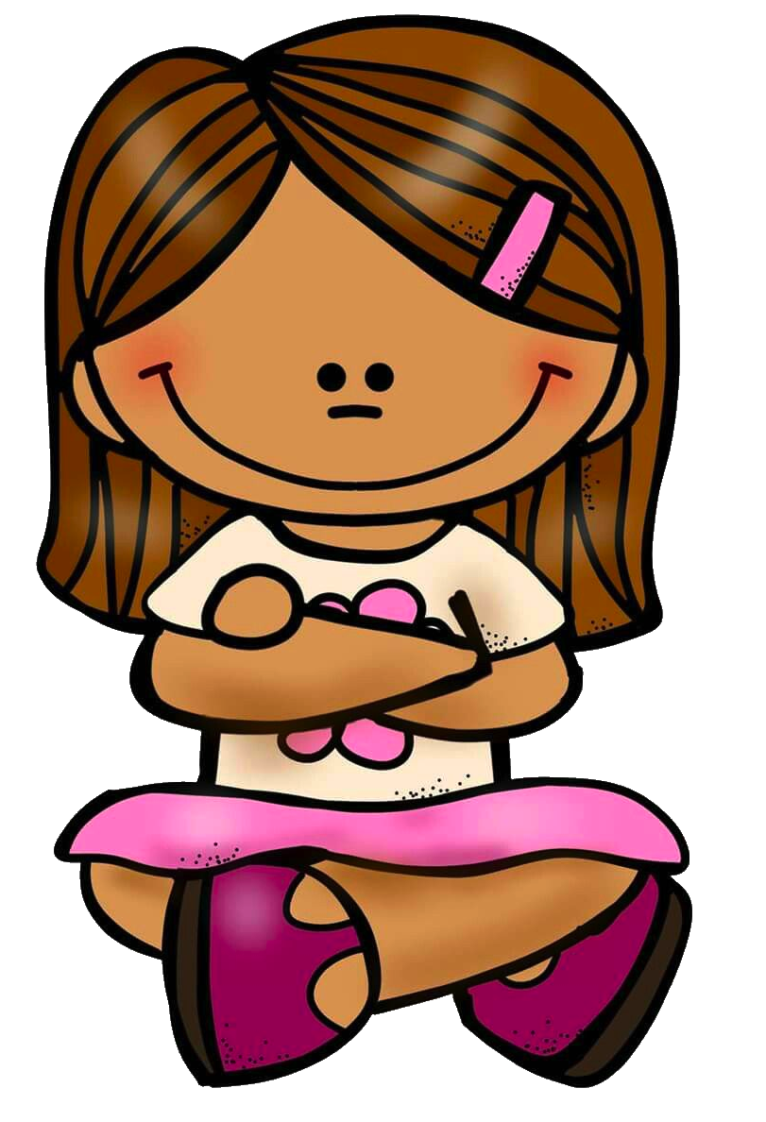
What are rules?
What are rules?
Do you know?
Notes:
How might Scrappy be different if there were rules? How would other people feel around Scrappy if he were following the rules?

Slide 15





What are rules?
Guides…directions…
Things we have to do even when we do not feel like it.
Rules help us stay safe and to be respectful of others

Slide 16
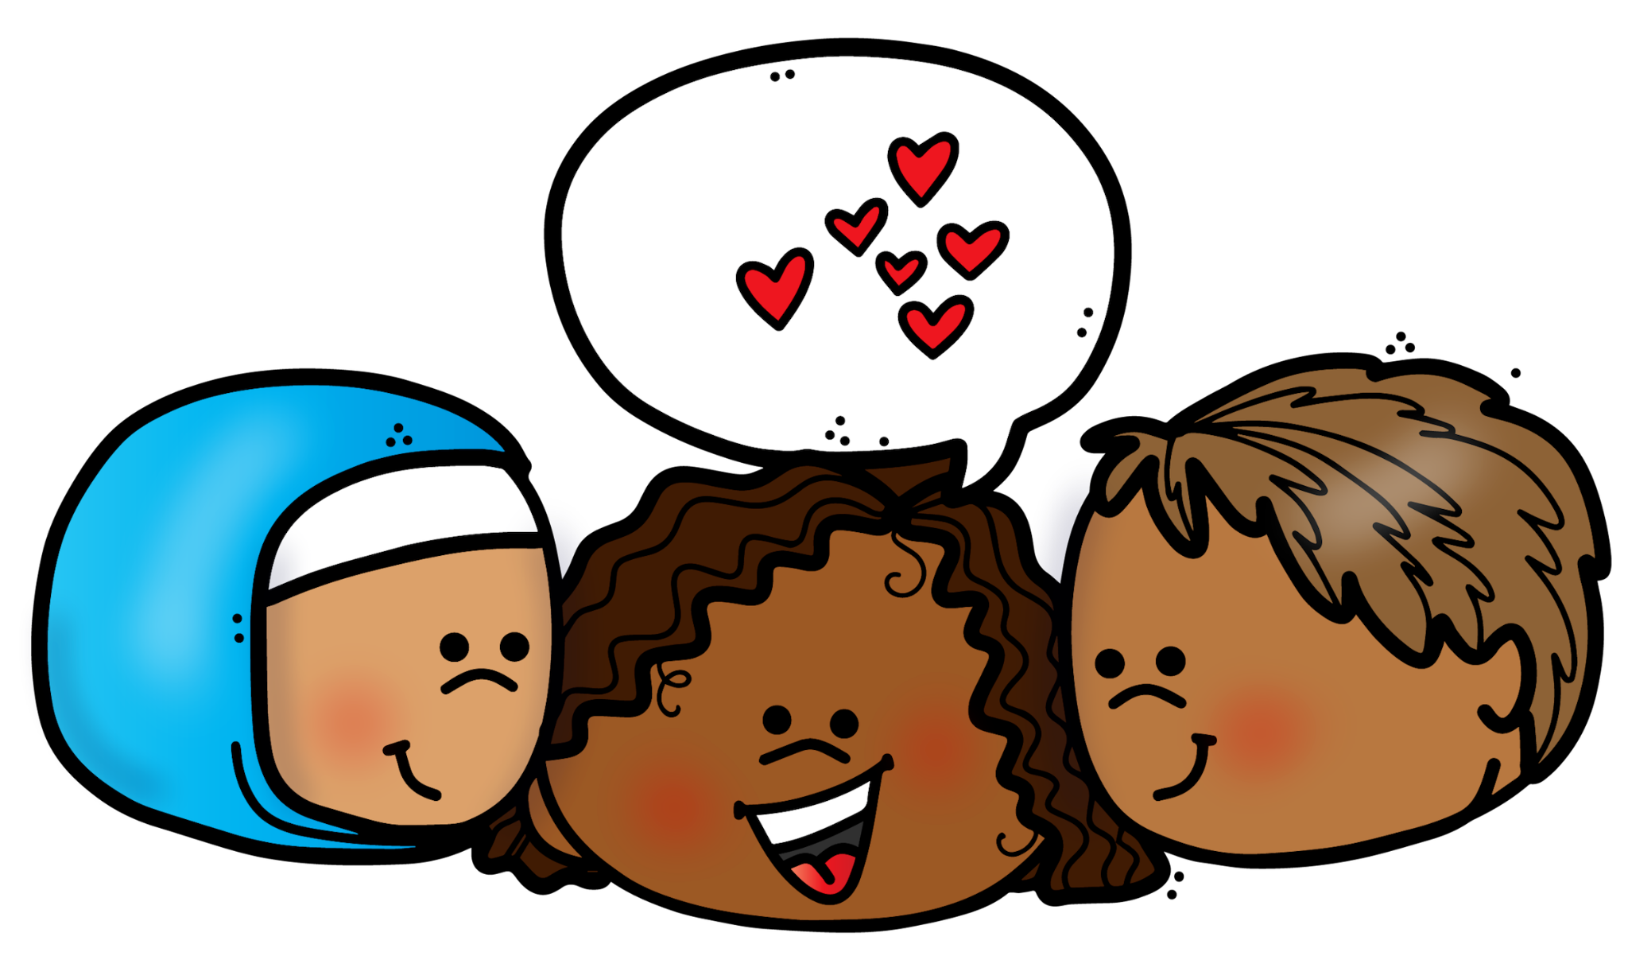
Respect each other
Respect the Rules

Slide 17

What is Respect?
Respect
think about
how other people feel

Slide 18
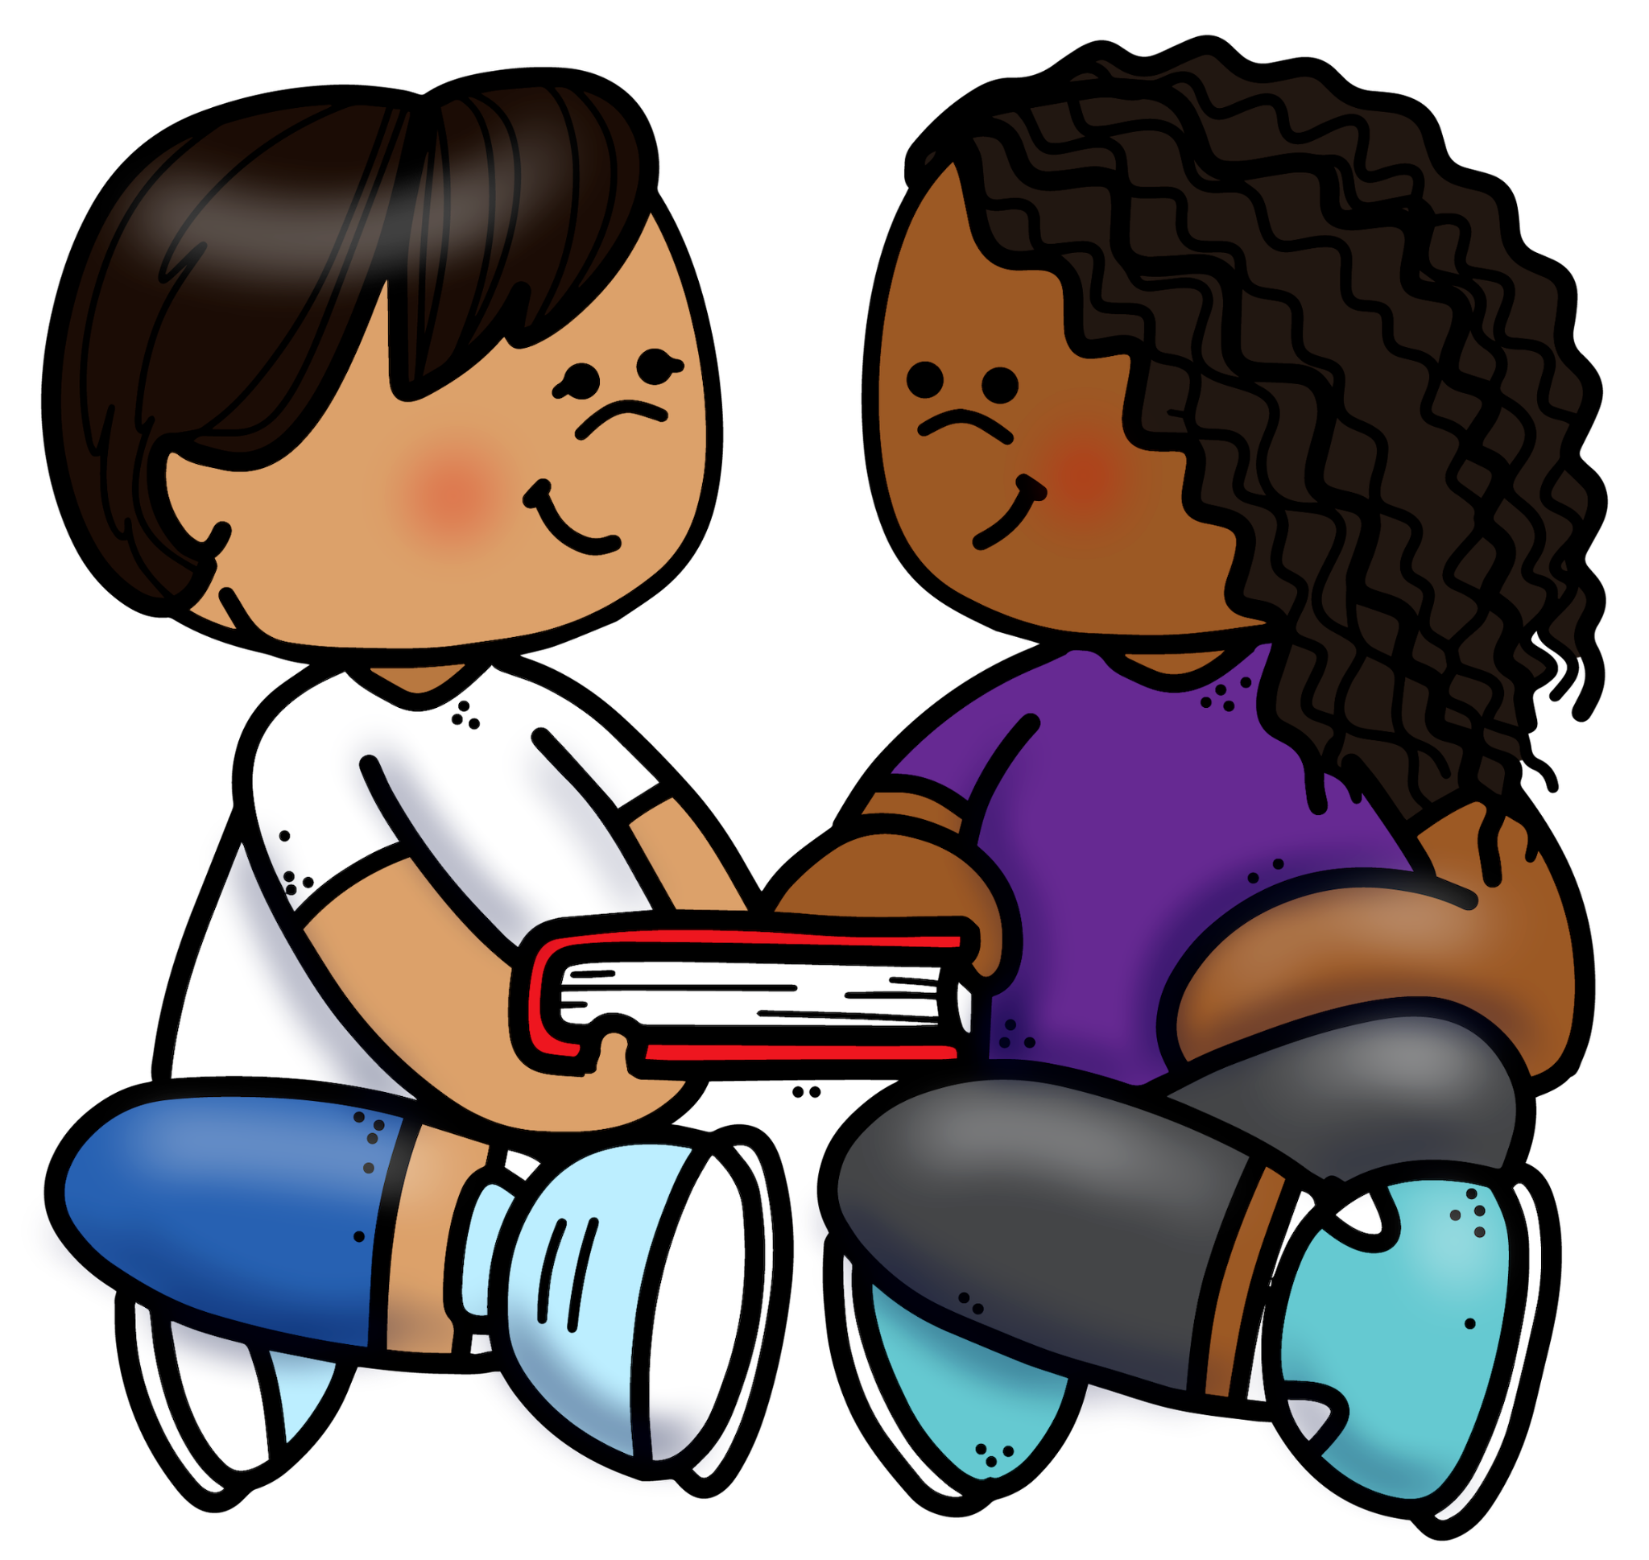
Respect
Being nice…
Taking turns
Sharing
Listening to Others
Caring

Slide 19
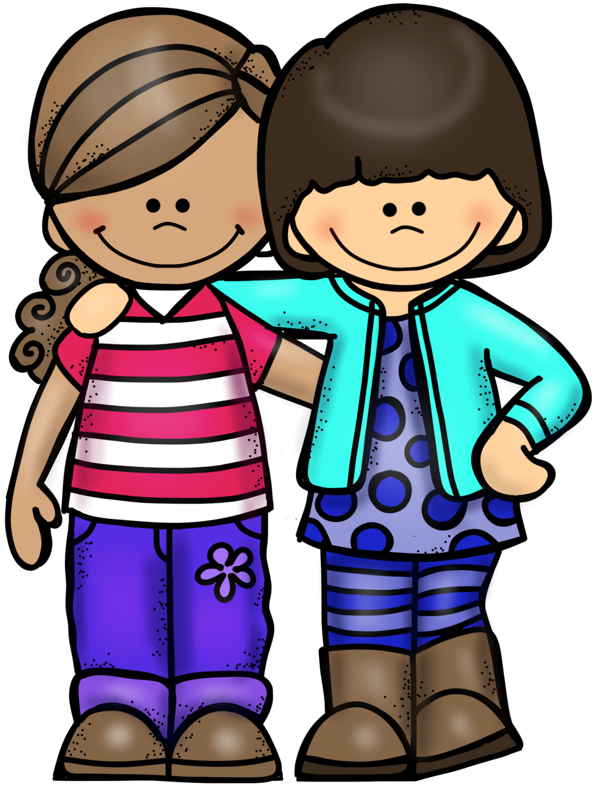
Follow the A B C’s
of Safe Learning
Be Alert
Know that you Belong
Remember to Care
If you do these ABC’s you will be able to follow all of your schools rules

Slide 20

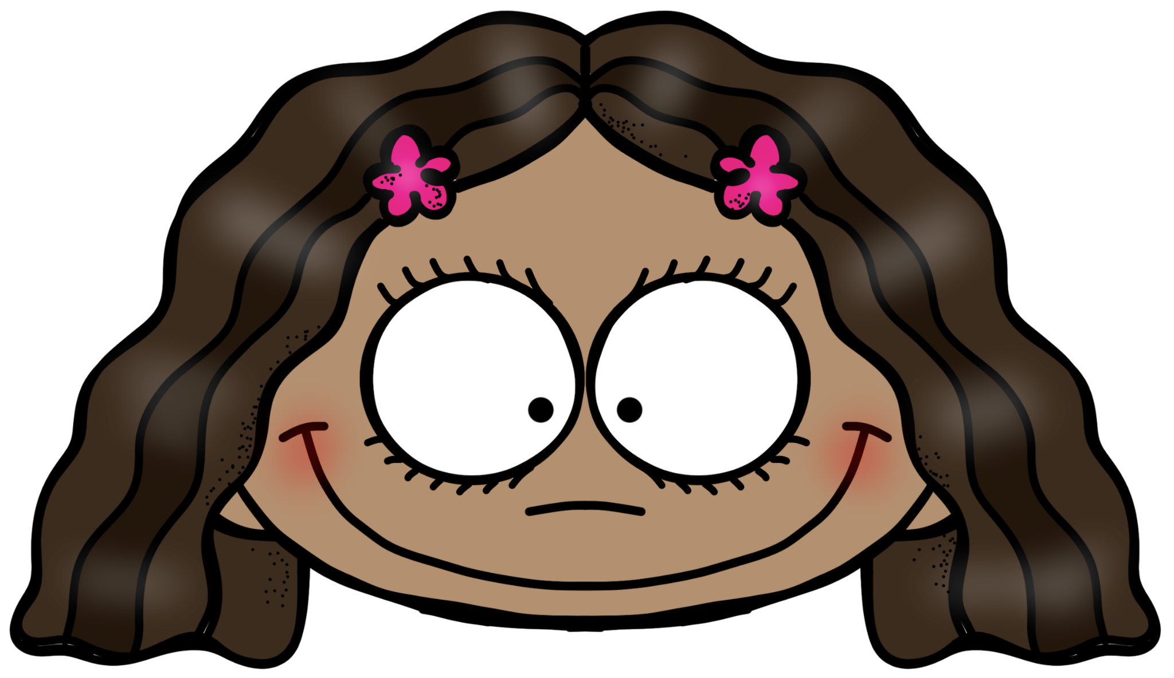
A B C’s of Safe Learning
A= Alert
Notes:
What does “alert” mean? When are you alert? (examples….crossing street…when hear a loud noise)

Slide 21
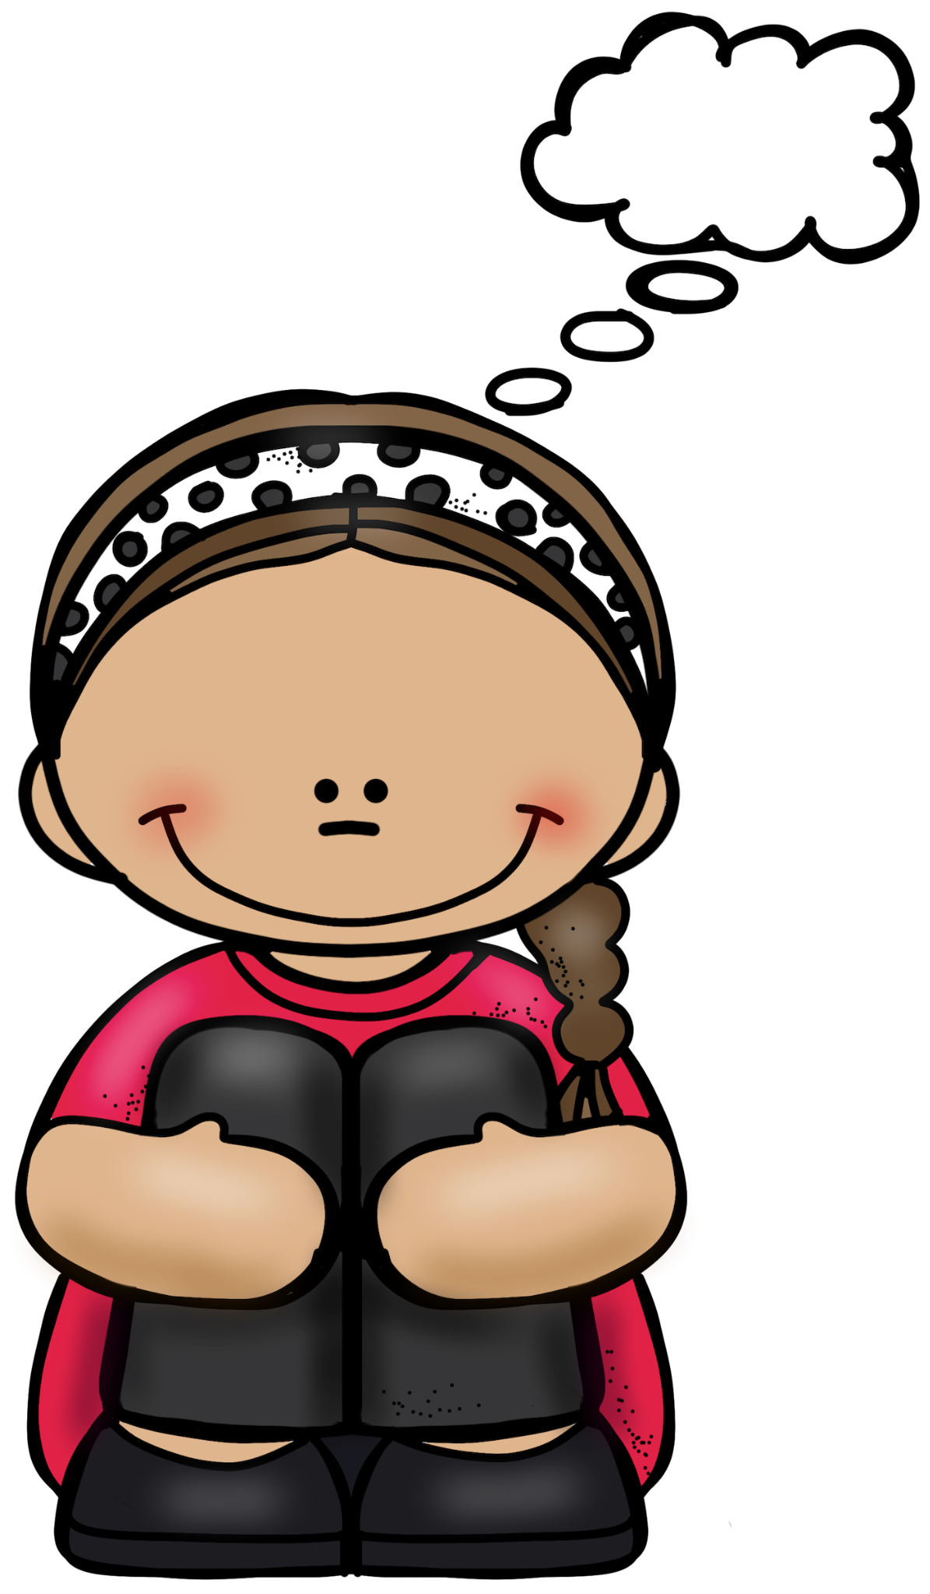


A= Alert
Keep your eyes and ears open
Think about those around you.
So nobody gets hurt.

Slide 22
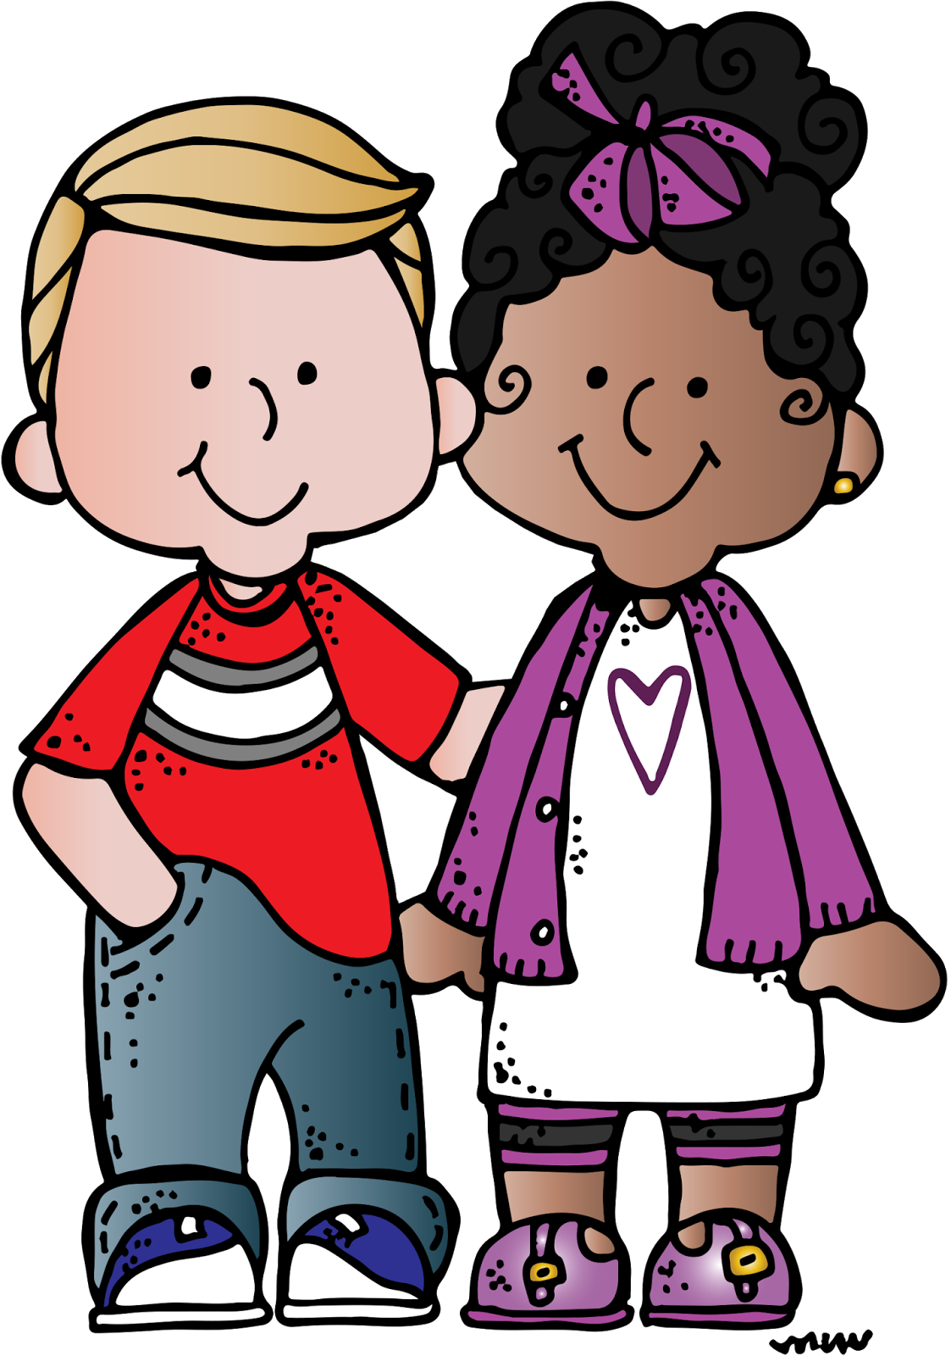
A B C’s of Safe Learning
B = Belong
Notes:
What does belong mean? When do you feel like you belong? (can use this slide to establish that we all belong in class and in school. All have a place here.

Slide 23

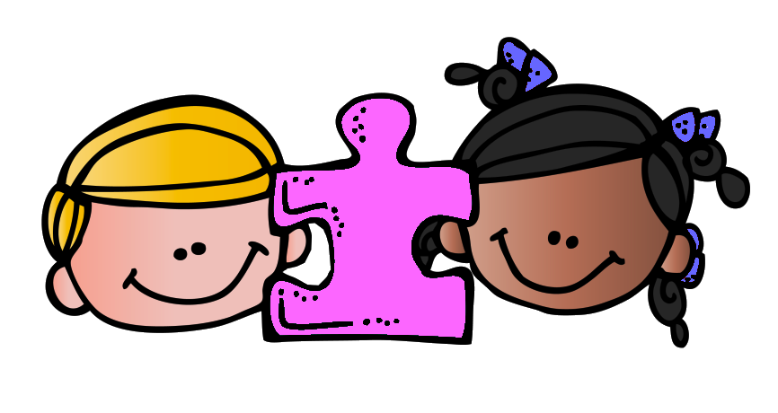
B = Belong
You are an important part of your school and your classroom
YOU are an important piece of the school and classroom puzzle

Slide 24



A B C’s of Safe Learning
C = Care
Notes:
What does it mean to care? When do you feel cared about?

Slide 25
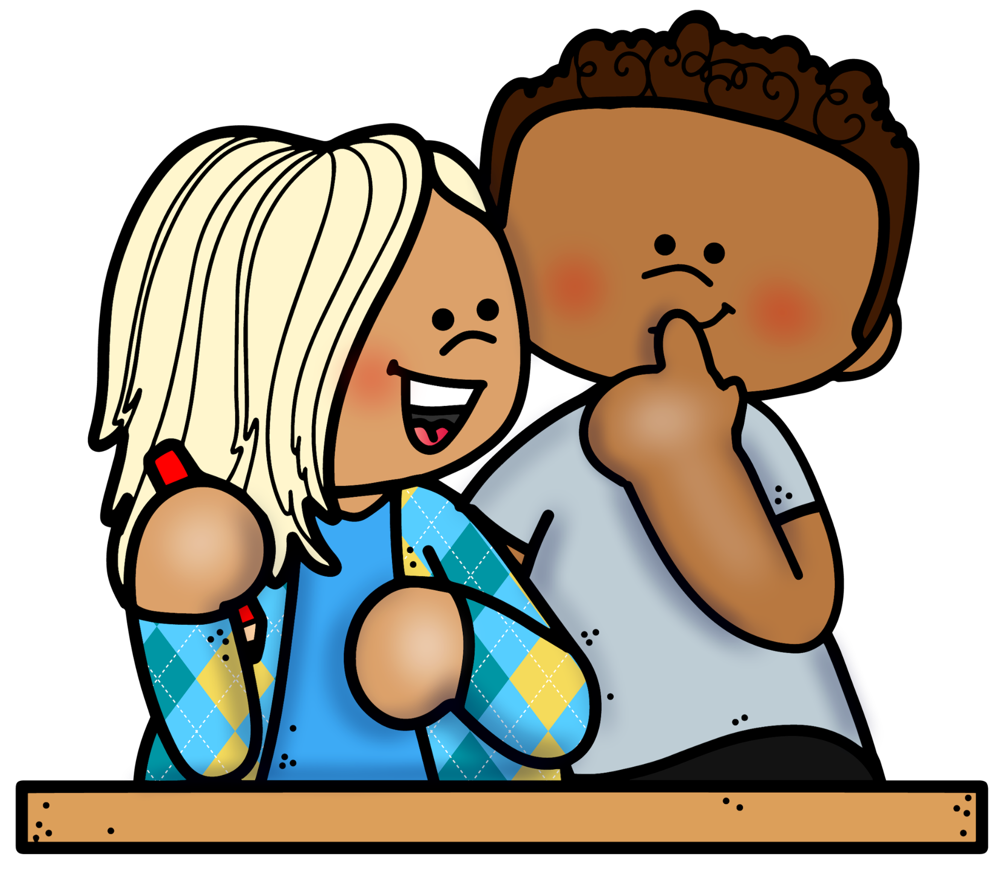
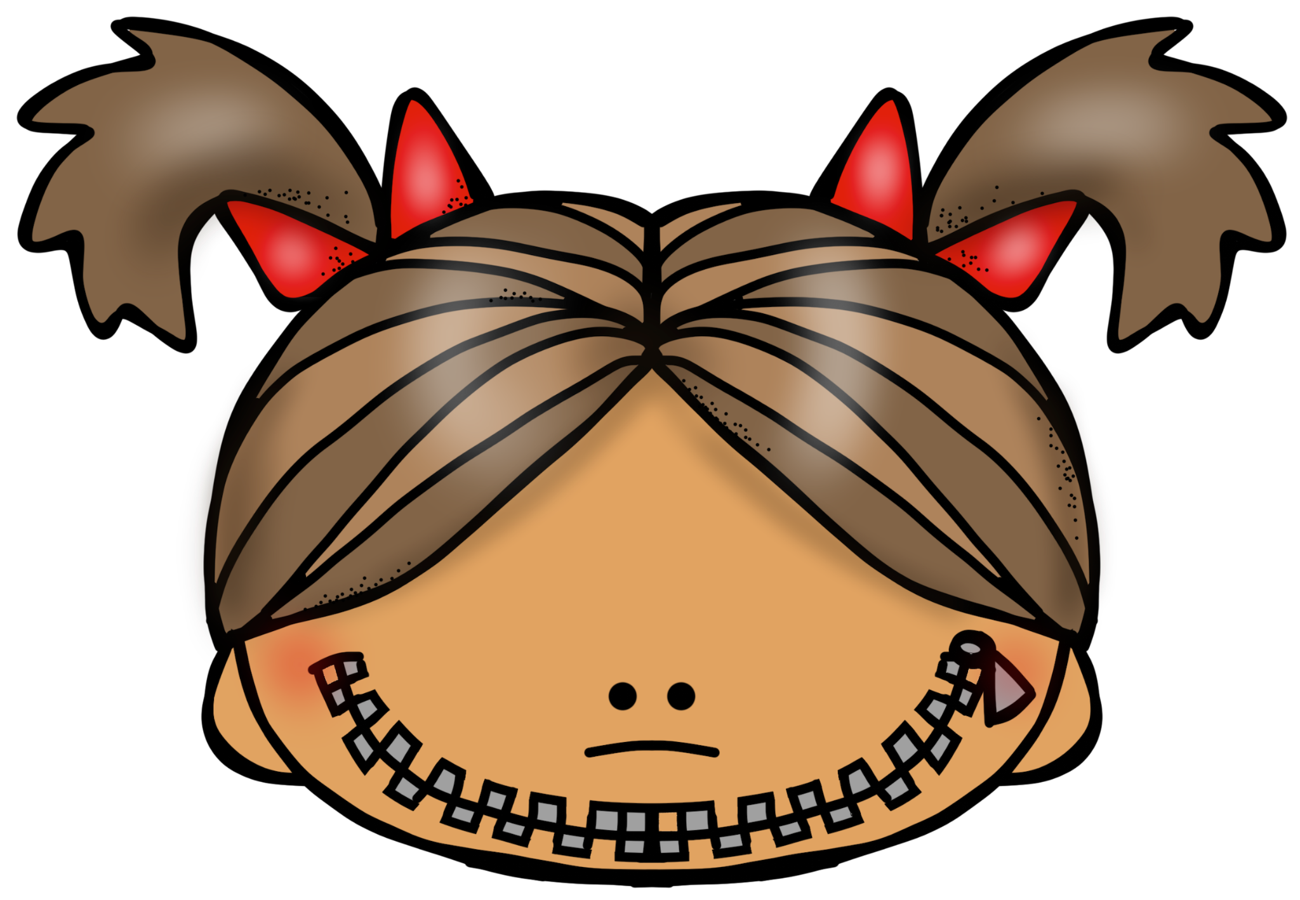
C = Care
Help others stay quiet at quiet times

Slide 26


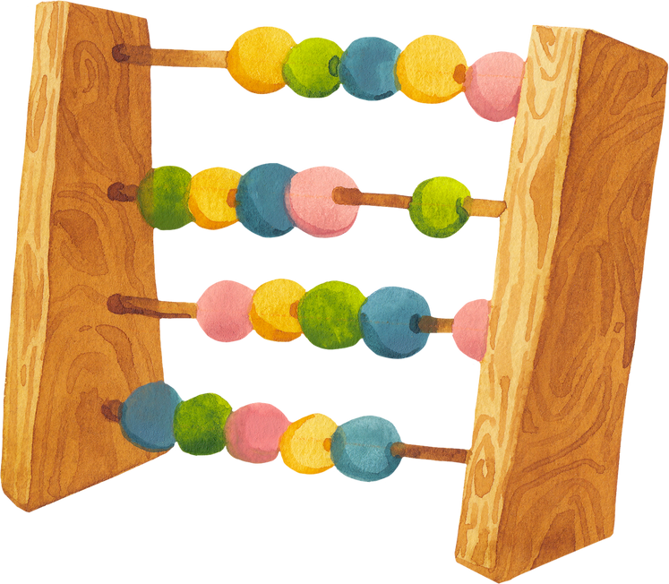

A school without the
A B C’s of Safe Learning

Slide 27


Is like a car without wheels
Notes:
What would a car without wheels be like?

Slide 28

The car would not go anywhere!
Notes:
Tell me something else that could happen if a school did not have any rules.

Slide 29

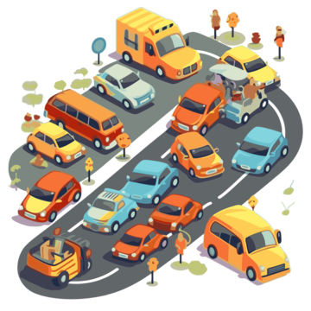
..a busy street without a stop light
Notes:
What would happen if there were not stop lights or street signs?

Slide 30
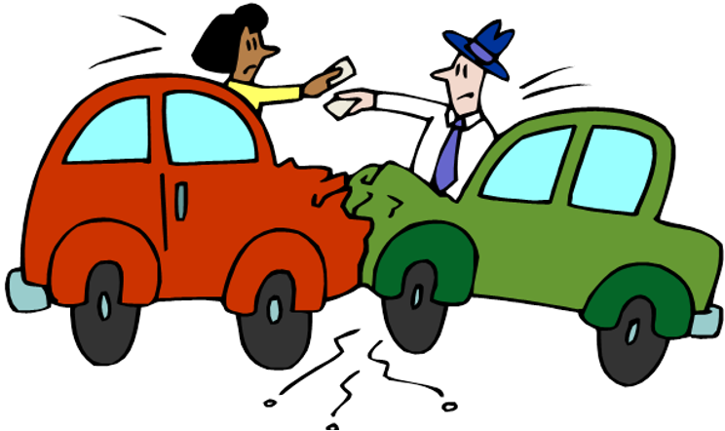

Cars would hit into each other…
people could get hurt!
Notes:
Share one more thing that could happen at school if there were not rules.

Slide 31


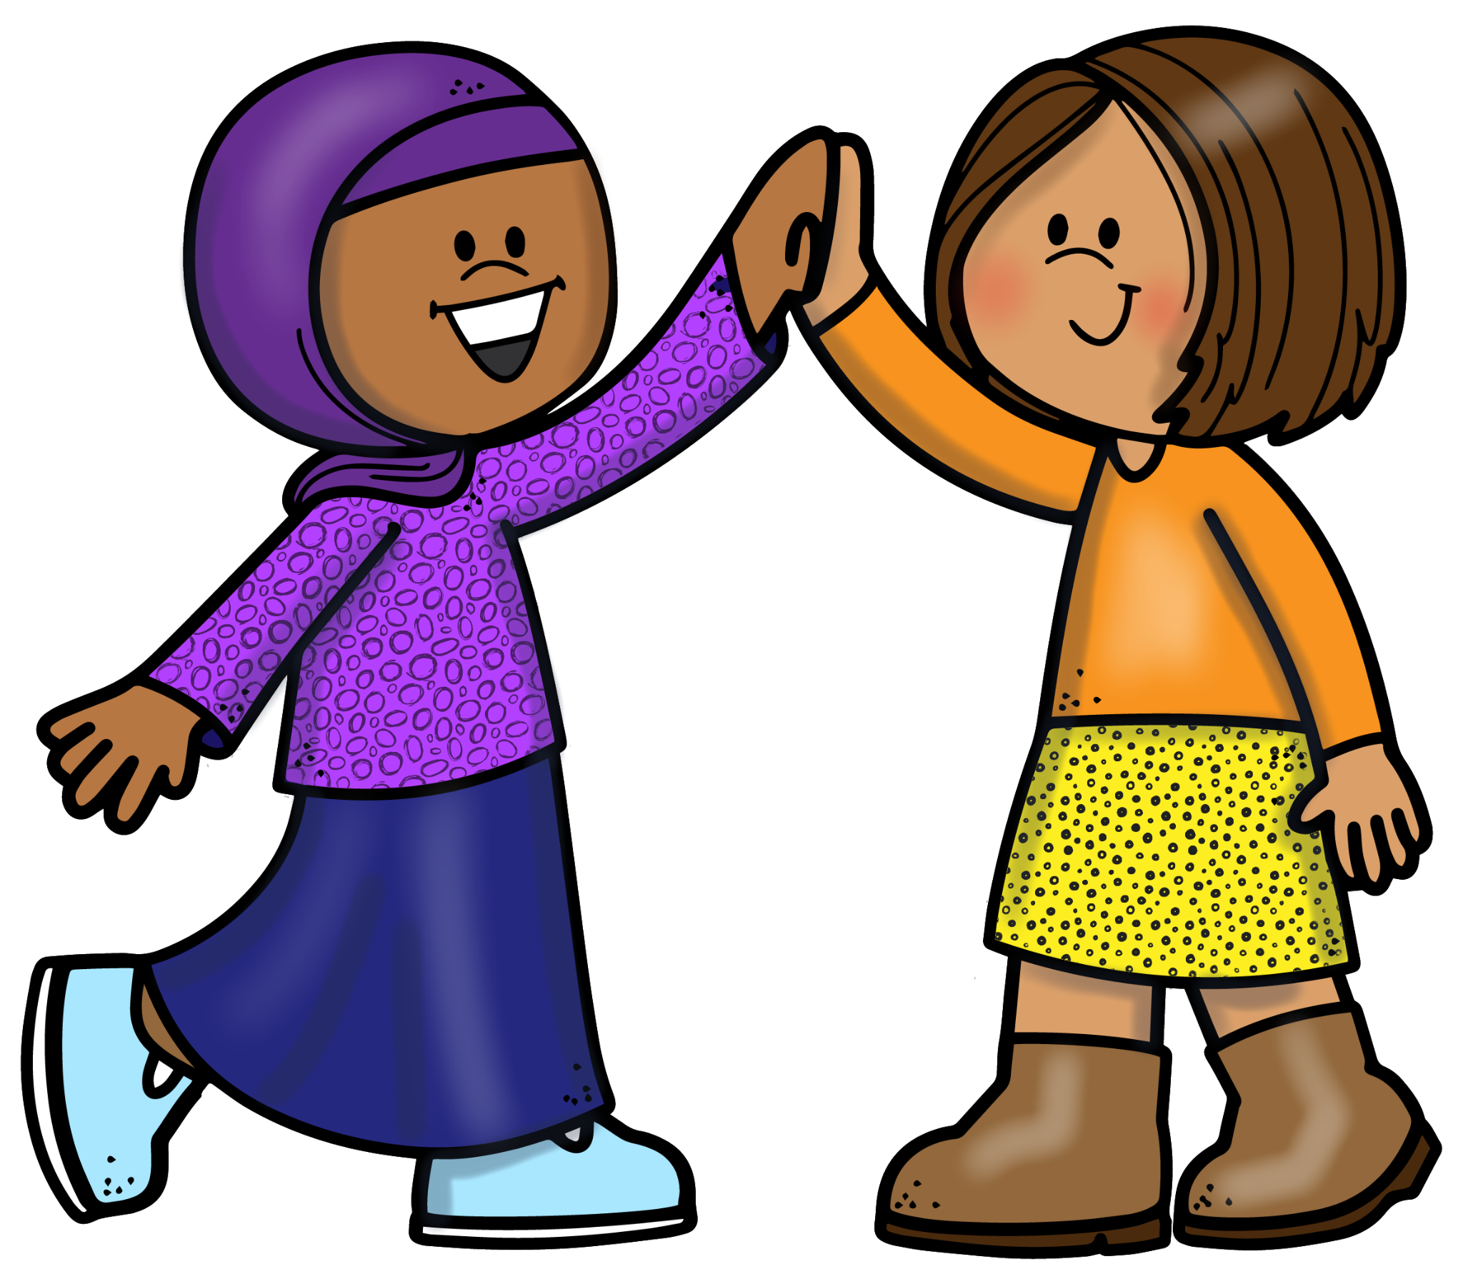
So…We Come to
School to Learn

Slide 32
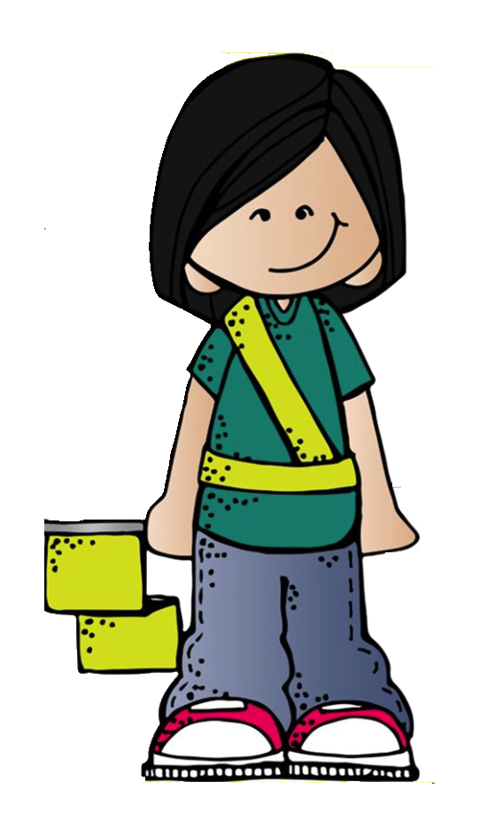
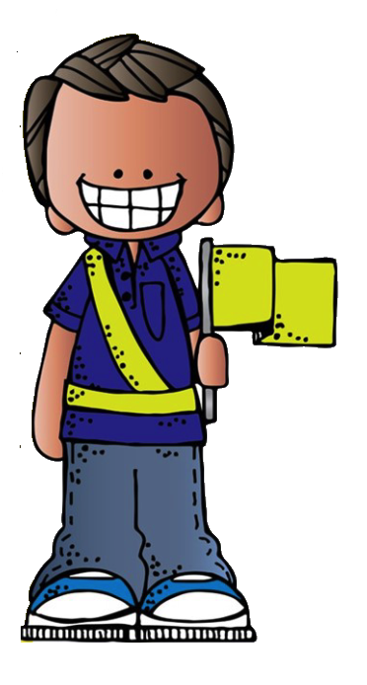
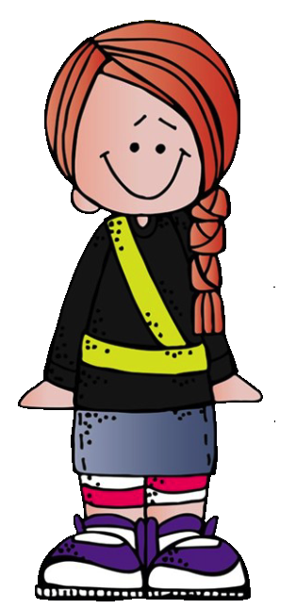
And to be safe

Slide 33
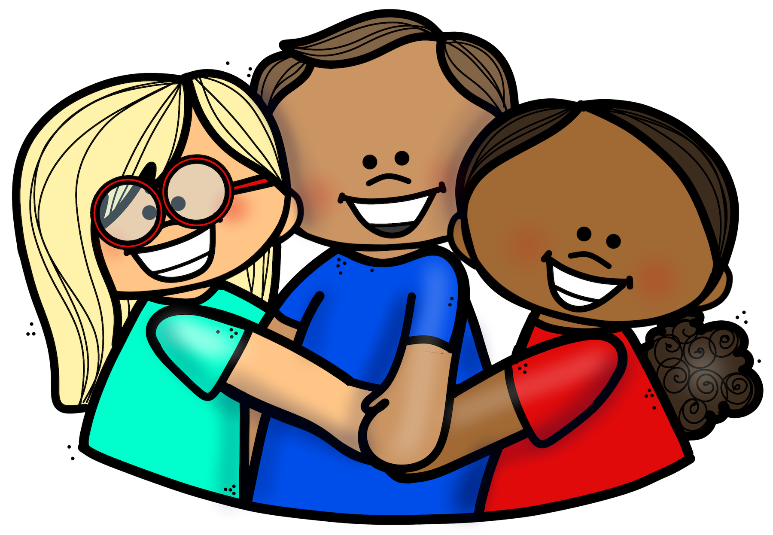
We need to follow the rules

Slide 34

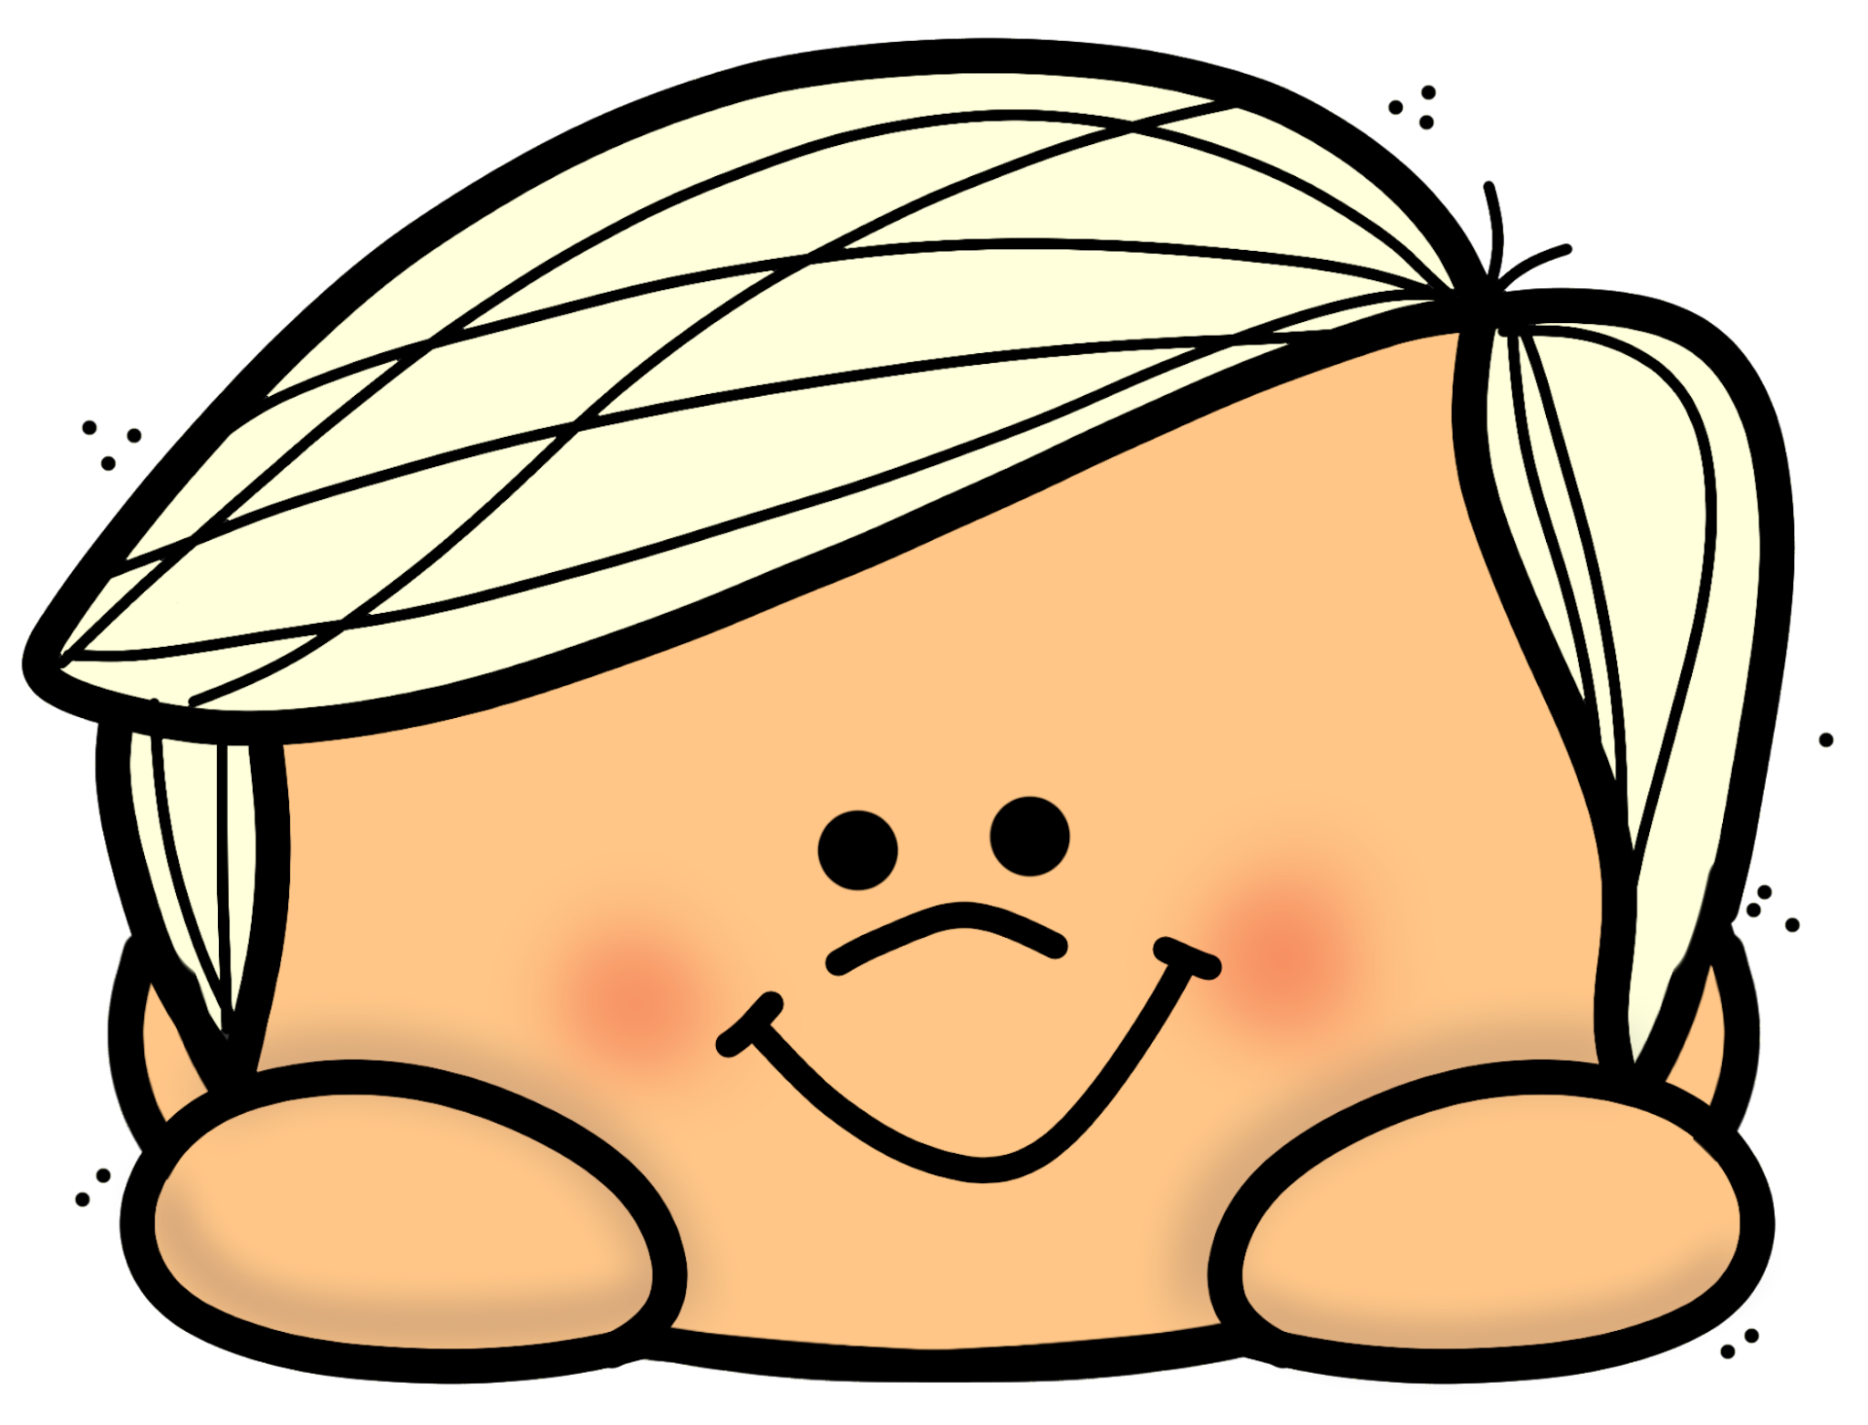
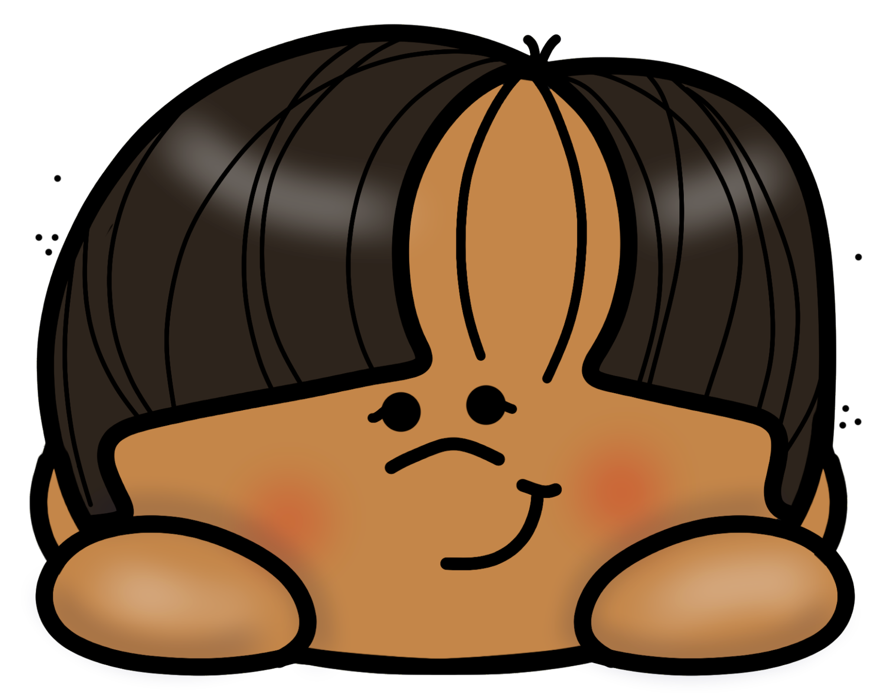


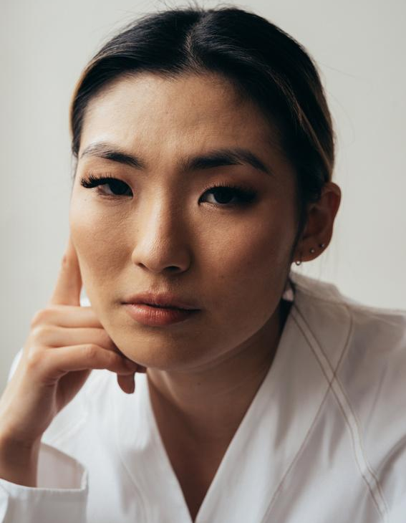
A B Cs of Safe Learning!
Have a safe…respectful school year
so nobody gets hurt and no one’s heart gets hurt… And you LEARN!!
Notes:
Ask them to tell you what the ABC’s of Safe Learning stand for.

