Slide 1



2025 - 2026
Code of Conduct Team Meeting
AP Mayer
SCC Goldman
SCC Draghi

Slide 2




Overview
01
02
03
Student Code of Conduct
De-escalation and Consequences
Role of Staff Members

Slide 3




01
Student Code of Conduct
Link

Slide 4

Levels of Infractions
01
Level 1 | Level 2 | Level 3 | Level 4 | Level 5
Uncooperative/ Noncompliant Behavior | Disorderly Behavior | Disruptive Behavior | Aggressive/ Harmful Behavior | Seriously Dangerous Behavior
-Disrupts the educational process (making noises) -Verbally Rude/ disrespectful | -Misusing property -Leaving class without permission | -Slurs based on race, gender etc -Physical altercation -Engaging in unwanted or inappropriate touch | -Physically aggressive behavior -Bullying -Serious statements (bomb threat, shooting, pulling fire alarm) | -Starting a fire -Conflict that results in serious injury

Slide 5
Infractions Breakdown:
2024-25 totals
01
 | Level 1 | Level 2 | Level 3 | Level 4 | Level 5
Total | 55 | 188 | 28 | 21 | 1
School Year (September - present) | 55 | 181 | 27 | 20 | 1
 | Level 1- 3 | Level 4 - 5
Total | 271 | 22
School Year (September - present) | 263 | 21
With the top 3 VIP Students total number of Incidents from last year -269 less incidents
Without the top 3 VIP Students total number of Incidents from last year -79 less incidents

Slide 6

Ladder of Support
Concurrent Support and Disciplinary Response to Misconduct
What is provided to address the inappropriate behavior internally
Universal Prevention for All Students
What is provided to address the inappropriate behavior school wide (Leader in Me, Crisis Team)
Initial Response(s)
Teacher contacts the student’s family and follows one or more of the following: has a conference with the student; refers the student to a school counselor, the Pupil Personnel Team (PPT), and/or the Climate Coordinator.
Supports and Interventions*
Disciplinary Response Options*
*covered later in presentation
01

Slide 7

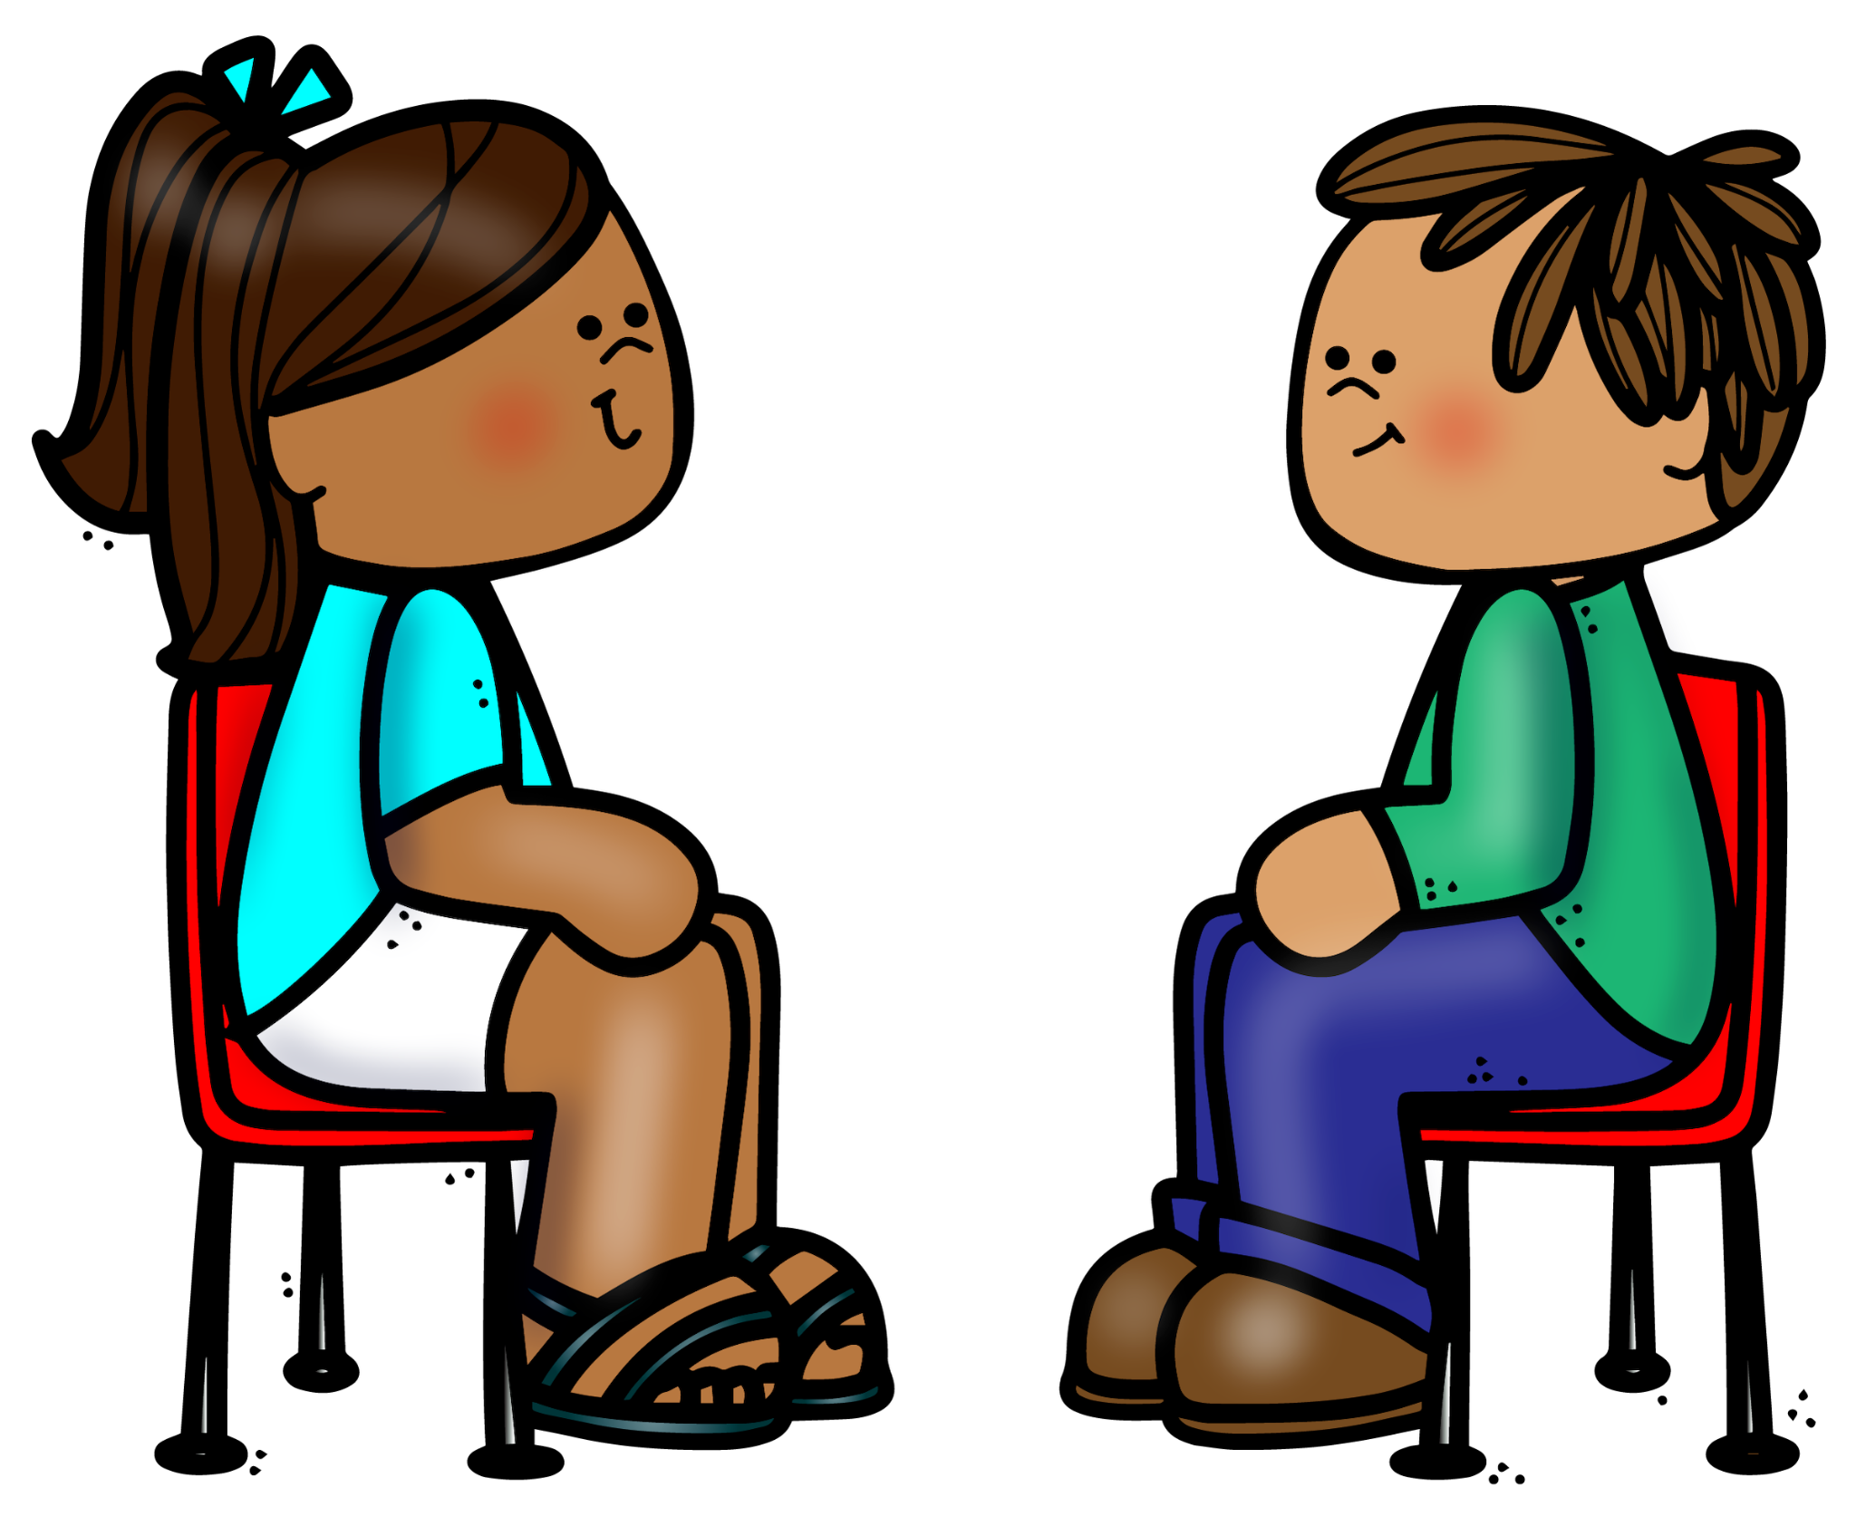
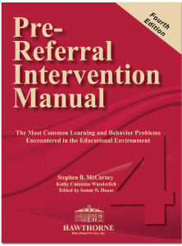
Ladder of Support
Supports and Interventions
01
Conflict resolution
Development of Individual behavioral contract
Functional Behavioral Assessment (FBA)/Behavioral Intervention Plan (BIP)
Guidance conference
Health education
Individual/group counseling
Individualized Support Plan (ISP)
Intervention by counseling staff
Mentoring
Parent Outreach
Positive behavioral interventions and supports
Referral to a community-based organization (CBO)
Referral to Pupil Personnel Team (PPT)
Social emotional learning
Notes:
Solution PRIM book for ways to support behaviors with interventions

Slide 8



Ladder of Support
Disciplinary Response Options*
School staff meeting with student to address the misbehavior and its impact
Student/teacher conference
Formal meeting with student by appropriate supervisor (e.g., assistant principal, principal) to address the misbehavior and understand its impact
Parent conference
Other in-school disciplinary response (e.g., formal restorative conference, exclusion from extracurricular activities, or communal lunchtime)
*every effort should be made to address substantially disruptive classroom behavior using
disciplinary responses A–E along with appropriate supports and interventions prior to
implementing a teacher removal (pg. 12 NYC DOE Discipline Code)
Teacher Removal or Principal’s Suspension
Principal’s suspension (up to 5 school days)
Superintendent’s Suspension
01
This all is dependent on a case to case
(level infraction, age/ grade level, and SPED)
Goal
The goal is to foster social emotional growth and pro-social behavior and prevent future misbehavior.

Slide 9




02
De-escalation and Consequences

Slide 10



behaviors
01
02
03
02
  The escalation of behavioral interventions and potential consequences
  The difference between general de-escalation and specialized de-escalation protocols
  The difference between the concept of punishment, consequences, behavioral interventions and potential consequences

Slide 11


Behaviors
Level 1 | Level 2 | Level 3 | Level 4 | Level 5
Uncooperative/ Noncompliant Behavior | Disorderly Behavior | Disruptive Behavior | Aggressive/ Harmful Behavior | Seriously Dangerous Behavior
Verbally Rude/ disrespectful | Hitting another student | Physical confrontational behavior toward students or school personnel | Bullying Investigation | Conflict that results in serious injury
Grades K-5 Staff meeting with student to address misbehavior and its impact PRIM behavioral concepts and intervention supports Student/ teacher conference Formal student meeting with principal/ assistant principal to address behavior Parent conference In-school disciplinary response (restorative conference, exclusion from extracurricular events or lunchtime) Teacher class removal |  |  | Grades 4 & 5 only Principal suspension Superintendent’s suspension
01
  The escalation of behavioral interventions and potential consequences
  Code of Conduct
  De-escalation Memo
02

Slide 12



De-escalation
02
General
Calm-down bucket
  The difference between general de-escalation and specialized de-escalation protocols
Break
02
Choice
Specialized
This should be done first by the teacher incharge during that time then follow the protocol
Individualized
Created by Team
Teachers call extension x1092. Secondary extension x1000.

Slide 13

Behaviors
Punishment
The motivation behind a punishment comes from a place of emotion and a need to maintain control. It focuses on shame, guilt,or impose authority. This includes facial expressions and tone of voice.
03
02
  The difference between the concept of punishment and behavioral interventions and potential consequences
Behavioral Interventions
Actions to take to improve or replace the behavior.
Examples: breaks, proximity, check-in,
Consequences
Consequences are meant to teach, maintain accountability, and maintain safety, is based off evidence.
Notes:
Privacy, once address the behavior move on and create a clean slate

Slide 14
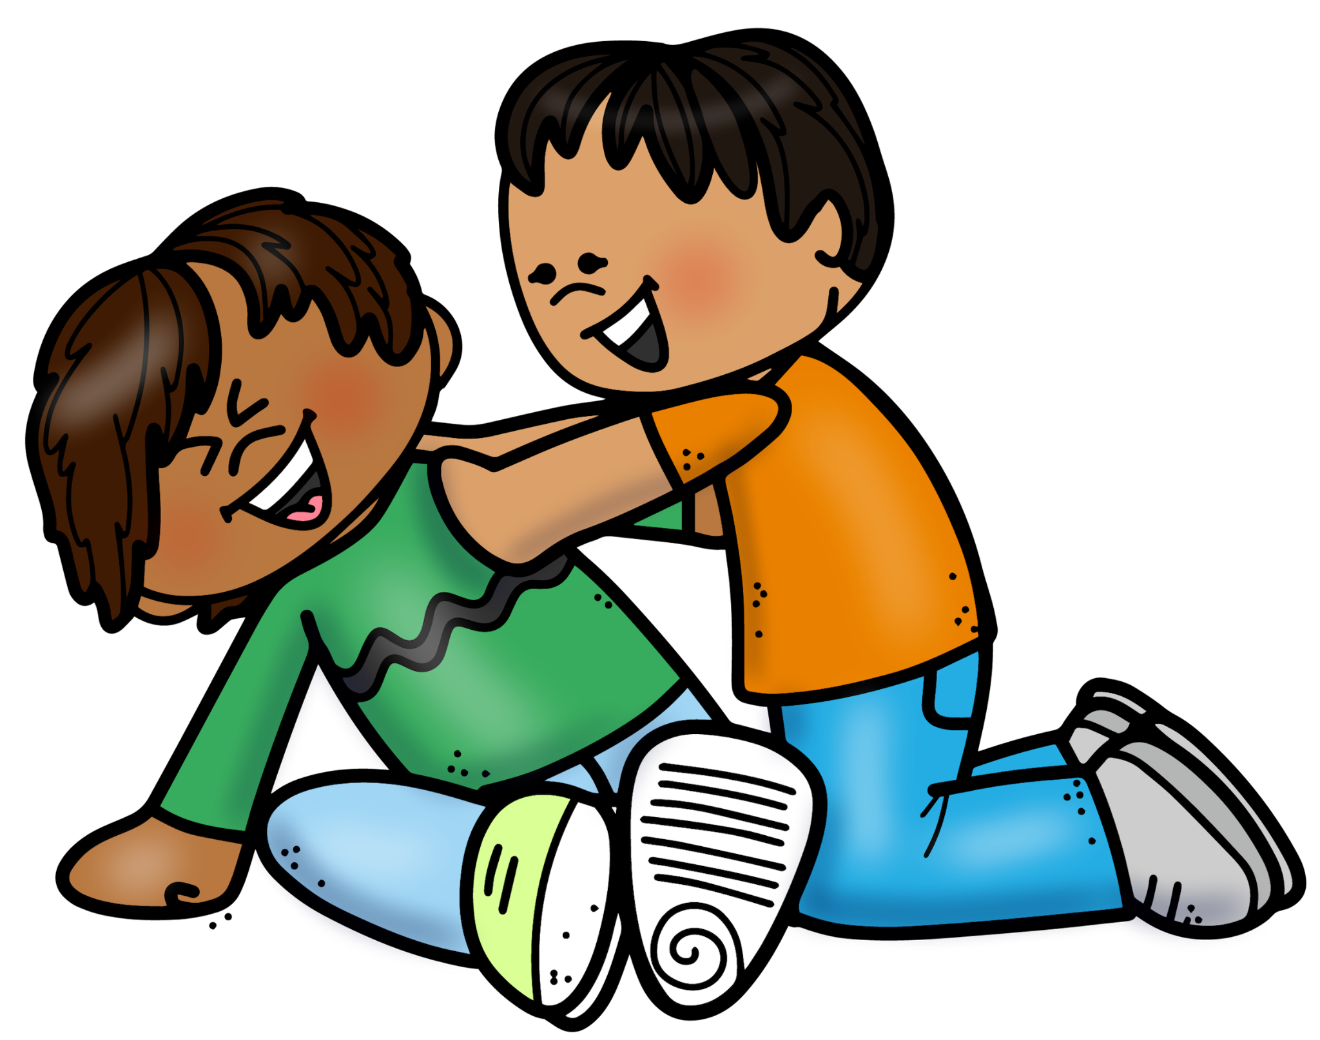
Starting Point: Redirect Behavior
Start with a positive: compliment others on a targeted behavior (be very specific)
02
Ask a question
Instead of saying: You don’t talk to teachers that way.
Try: Why do you think you should talk to someone like that?
Avoid negative speech
Instead of saying: Don’t hit student.
Try: Keep our hands to ourselves. What are your hands for?
Notes:
Ask a question- makes students think of a reason behind their behavior, when they are thinking about it can help stop that behavior
Complement targeted behaviors in others- student may stop to observe what others are doing or who might being praised

Slide 15


Logical Consequences
Consequences
can not be the only
method to stop negative behavior
Must be related to the
02
behavior
Respectful of the student
Reasonable for the
student to carry out
  Logical consequences are the key to determine a difference of if it is a punishment or consequence.
Revealed in advance
(when possible)

Slide 16
Potential Consequences
Level 1:
Do not give an award
Immediate re-do
Apologize
Parent involvement (call)
Verbal warning/ private chat
Proximity/ redirection
01
Level 2:
Loss of a Privilege*
Limited choice (this or that)
You break it, you fix it
Behavior Contract
Behavior Reflection*
02
02
Reflection Table
Seat change
Give them a job*
Parent-Teacher-Student conference
Level 3:
03
Level 4:
Loss of participation in a preferred activity
Loss of ice cream/ recess*
Revision of Behavior Contract with parent involvement
04
>>> As soon as a positive behavior is shown the student should be praised. Ex: not sitting, sits for a 1 sec. nice job sitting.
Notes:
Loss of Privilege: was door holder, no longer the door holder that day. It is something that they earn but cant do short term. You can’t take away a trip because that could be considered corporal punishment
*** classroom teachers cannot take away from recess or put students at the reflection table without their supervisors permission
Behavior Reflection: younger grades- draw a picture of what happened talk about it, what can you do different next time, older write about their behavior and what they could have done differently
You break it, you fix it- if a student purposefully throws something, knocks a chair over, when they calm down have them help clean up the mess they created
Give them a job: if they are struggling with not hitting others when packing up have them have a job that they can help in the classroom but takes away the opportunity to hit others ex: check to see what pencils need to be sharpened
Loss of Ice Cream/ Recess/ lunch: has to receive permission from direct supervisor prior (will be discussed in upcoming task force)
>>> if you don’t receive permission prior parents could complain and report you for corporal punishment by receiving permission prior it is a way to keep yourself protected

Slide 17

03
Roles of Staff

Slide 18



Roles for Reporting Incidents
Reporter’s Role
Administration/ SCC’s Role
  Provide specific details
  Report within 24 hours
03
  Report within 24 hours
  Investigate
  Contact all families involved
  Written statements
  Send child to nurse
  Contact families if needed

Slide 19



Activity
Link
Looking at two different scenarios
Complete it independently
Discussion to follow each scenario
03

Slide 20


Activity
  Scenario:
  On March 1, 2024 Cora sucker punched Sabina. Sabina was terrified from the incident. Parents were not contacted because my prep has passed.
Look at the Incident
Refer to the Code of Conduct
Use the Code of Conduct to render a behavioral interpretation
03
Compare
What is the correct code?
What is an appropriate intervention?
Was there important information missing?
Link
Link

Slide 21
Activity
  Scenario:
  On March 1, 2024 Cora and Sabina from Class 1-555 were involved in an incident. It was reported to AP Brandon Mayer that when students were transitioning from the carpet to their seats, Cora hit Sabina with a closed fist one time on Sabina’s right wrist. Sabina had a red mark on her wrist and was sent to the nurse parents were notified at 2:10pm.
Look at the Incident
Refer to the Code of Conduct
Use the Code of Conduct to render a behavioral interpretation
03
Compare
What is the correct code?
What is an appropriate intervention?
Was there important information missing?
Link
Notes:
>>>Explain why it is important to add thorough, objective facts. This supports the SCCs in substantiated or unsubstantiated investigations and drawing meaningful closure.

Slide 22


Questions
Thank
yOU

